Slide 1
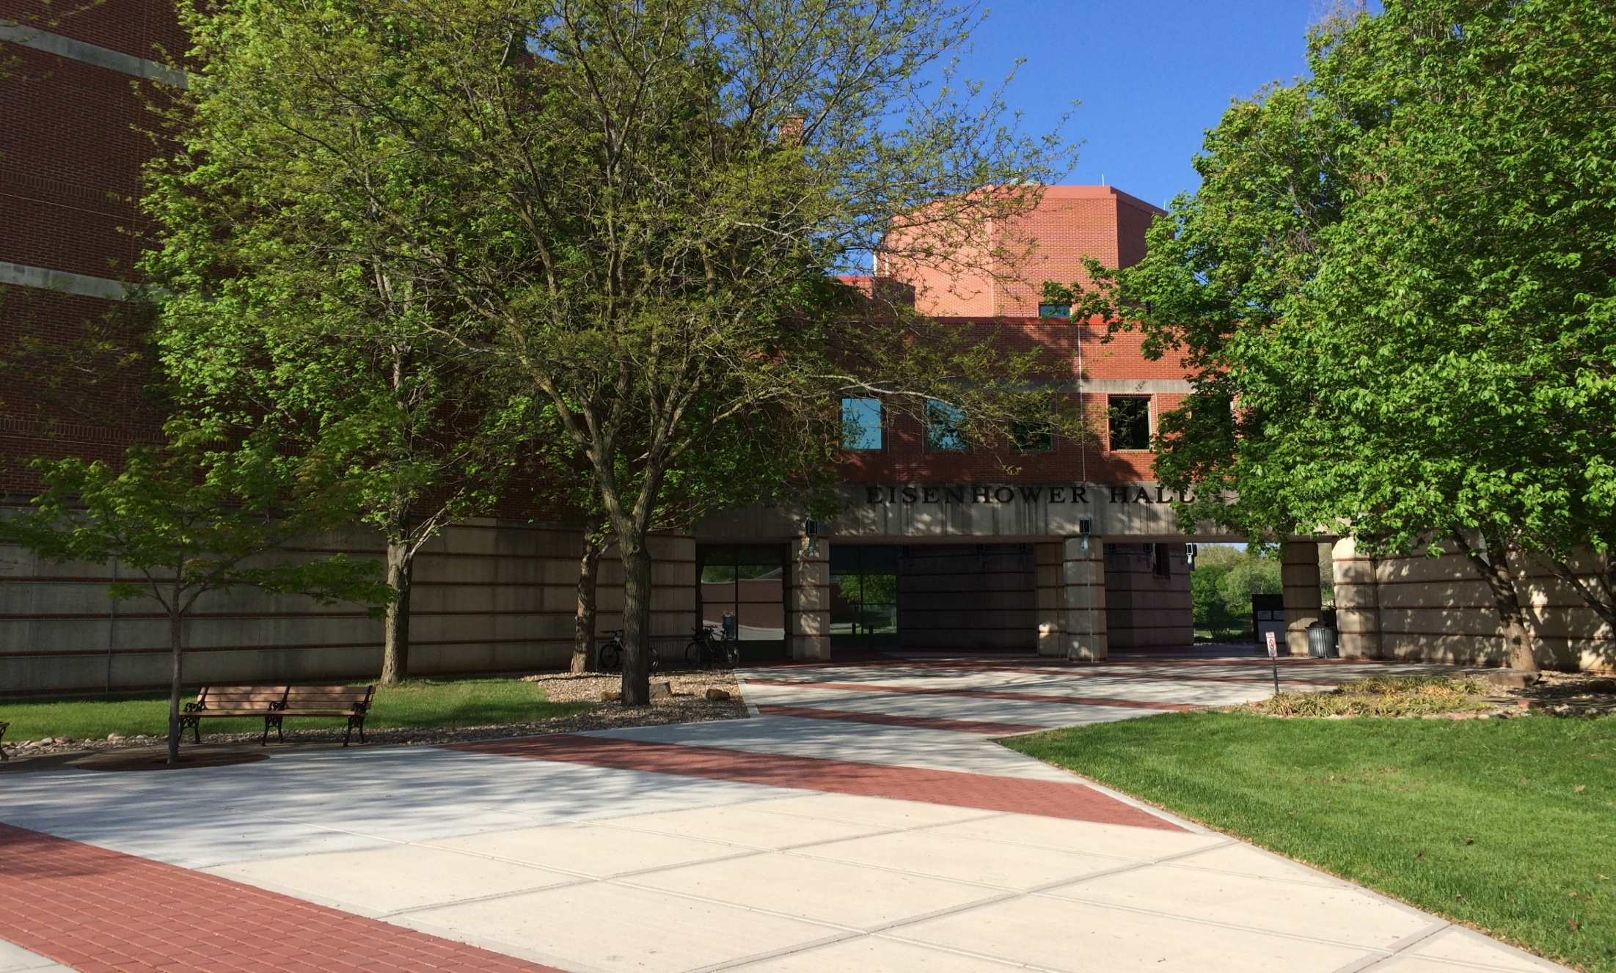
Ike Skelton
Combined Arms Research Library
(CARL)
AY27 CGSC Brief

Slide 2
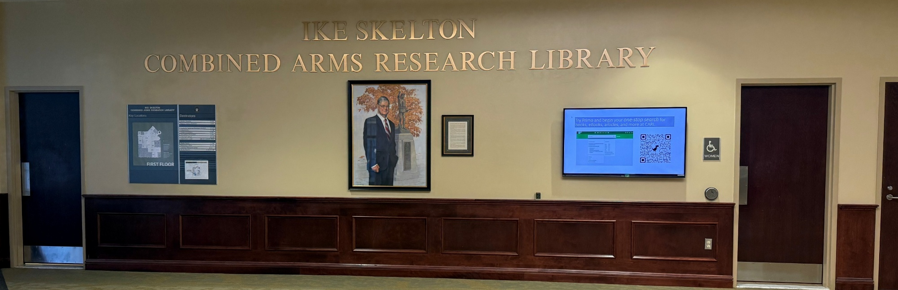
About CARL
Consolidated library
  Academic (CGSC)
  Post (Fort Leavenworth community)
300,000 physical items
Over 300,000 e-resources
Hours
  Monday-Friday 0700-1700
  Closed Weekends & Federal Holidays
Three floors
Mon-Fri 0700-1700
Notes:
Welcome to the CARL. We are the Army’s second largest library and the only remaining consolidated library. As a consolidated library we serve two missions, first and primary as the academic library for the students of CGSC, resident and distance. Second as the post library for the Fort Leavenworth Community. CARL has 3 Floors each with a different focus, more about that in later slides. Our physical collection consists of over 300,000 items, while our online 24/7 e-resource is easily an additional 300,000 items, including journal articles, ebooks, and newspapers. CARL has a variety of events and information to share, and our lobby kiosk (shown above) and our homepage are good places for updates. This picture also answers our most asked question-The bathrooms are located right inside the lobby on the first floor, and right above them on the other floors. Our hours are 0700-1700 Monday through Friday, closed Federal Holidays

Slide 3
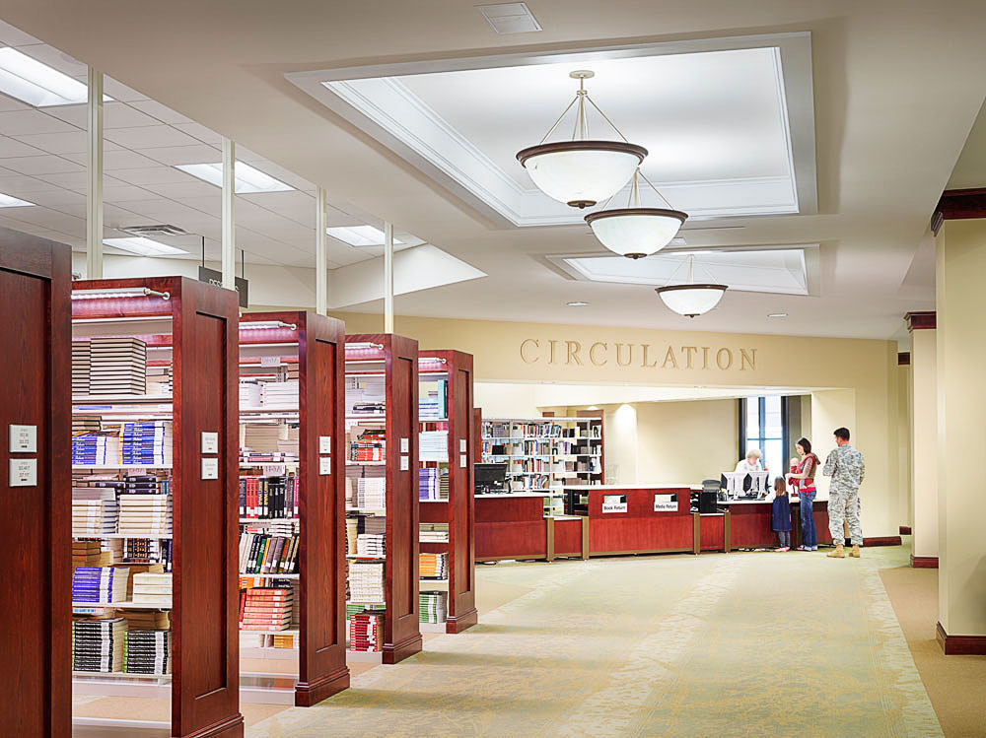
First Floor
Academic Resources
Textbooks
  CORE/AOC
  Electives
New Books
In Library Use materials
  Whiteboards
  Reserve readings
Commercial computers
Commercial printer
NIPR printer
Study rooms
Periodicals
Microfilm machines
Flatbed scanner
Notes:
Our First-Floor acts as our service floor, where you can get assistance from staff at the circulation desk and reference areas. In addition, it is the location of multiple Academic Resources as listed above and more detail below
New Books (Adult)
items that will eventually join regular collection and some popular materials that are leased for a time.
Non-Fiction
Fiction
Community Computers
Check out password at circulation desk
16 Dual Screen
Printing
CAC Card keyboards available
AVD available
Study Rooms
Online reservation 24 hours 3 hours
Schedule on Window
No reservation first come first serve 3 hours
Catalog Computers
Home Page
Flatbed Scanner
Reference Desk/Office
Librarian assistance
Ask A librarian Online QR code
Periodicals
Current & Back Issues
Copier, Digital Sender
Microfilm Alcove
Microfilm Readers
Microfiche and Indexes
Official Histories
Course Reserves
CORE (green star)
Until Spring Break
Electives (course number)
After Spring Break
Circulation Desk
Check in/Check out Materials
Pick up Holds
Mobile White board checkout
General Information
NIPR Printer
Allows for AVD and AUDS printing
May allow for digital scanning

Slide 4
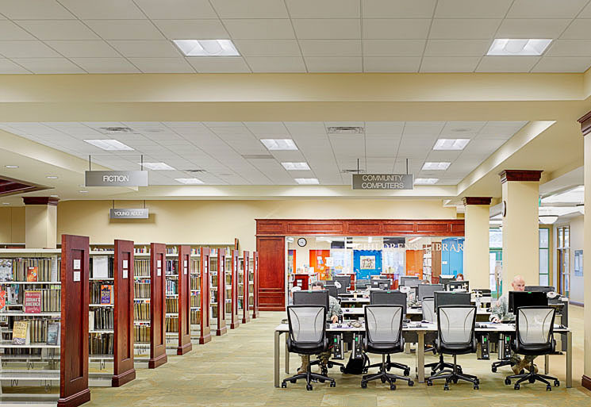
First Floor
Community Collection
Fiction
Graphic Novels
Young Adult
Children’s Room
  Board Books
  Easy Readers
  Chapter Books
  Graphic Novels
  Non-Fiction
DVDs
Video Games
Audio Books (CD)
Notes:
The first floor is also home to most of the community collection. Including Adult-Fiction/Graphic Novels, Young Adult-Graphic Novels/Fiction, Children’s Room (Board Books, Picture Books, Beginning Readers, Graphic Novels, Chapter Books (Fiction), Non-Fiction, STEM Kits).

Slide 5
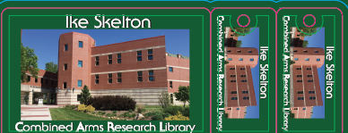
Library Accounts
Created automatically for enrolled students
One account per family (Family Account)
Must be activated at circulation desk
Access account online
  Reset password
  Place requests on items checked out
  View a list of checked out items
  Renew materials
Username
  Check email
Password
  Reset online or see staff at desk
Grants access to CARL e-resources
Notes:
In order to check out items or use resources at CARL you must have a library account. A shell account has been created for all incoming students, students or their spouse must stop by the circulation desk to activate their acct, confirm contact information and pick up a library card. Passwords may be created at that time or library staff can send a reset password link. If resetting password, best practice is for user to clear browser cache first before using the password reset link. For additional questions see the circulation desk staff.

Slide 6
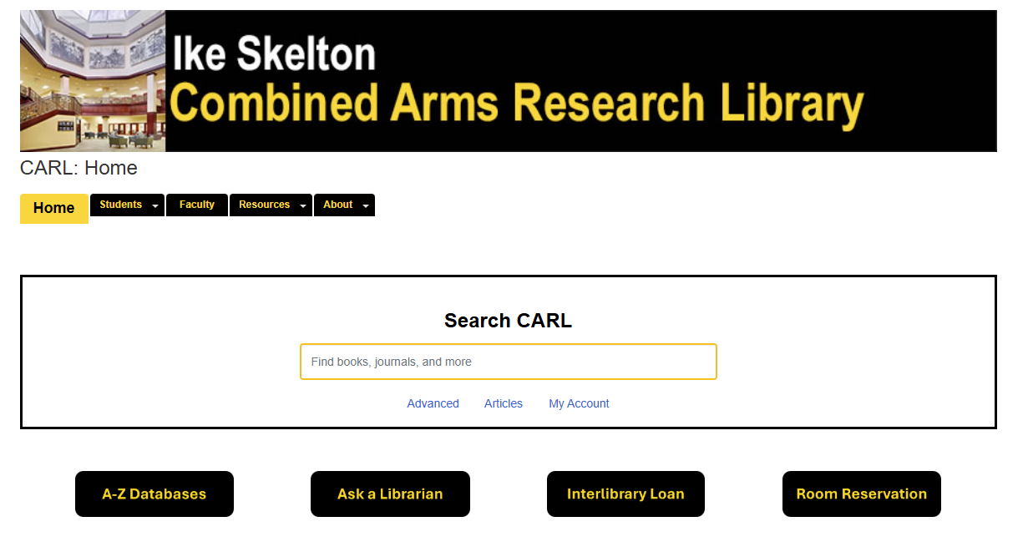
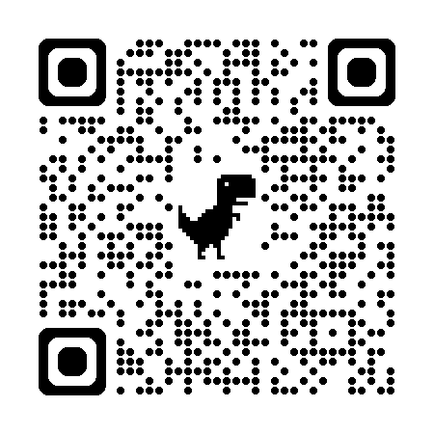
https://carlcgsc.libguides.com/home
        CARL Homepage
  6
Notes:
CARL’s homepage. This is the beginning location for all our online services. We have a quick search box located on the page and links to multiple other resources. Feel free to scan the QR code or look us up on your favorite search engine, just type CARL library and we should come right up. This is like searching your roku or firestick to see what the different platforms offer.

Slide 7
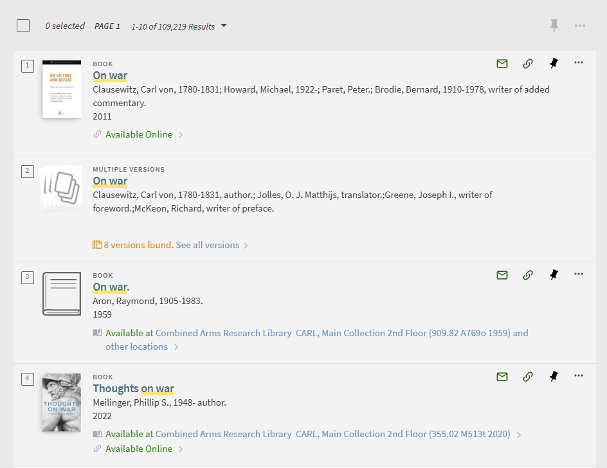
        Search Results
Notes:
Search results will show items both from our physical collection and e-resource collections. CARL is part of a shared catalog 16 libraries, Army University Library System (AULS) and you may see items from other libraries, particularly if our physical copy is checked out. (THIS SHOULD NO LONGER BE THE CASE-DB) This is a new system, and we are still fine tuning and migrating some data, so if you can’t find what you need, please reach out to staff member. This is a sample search for the terms On War. You will see that it shows online copies of your textbook, a multiple versions entry and other versions as well.

Slide 8
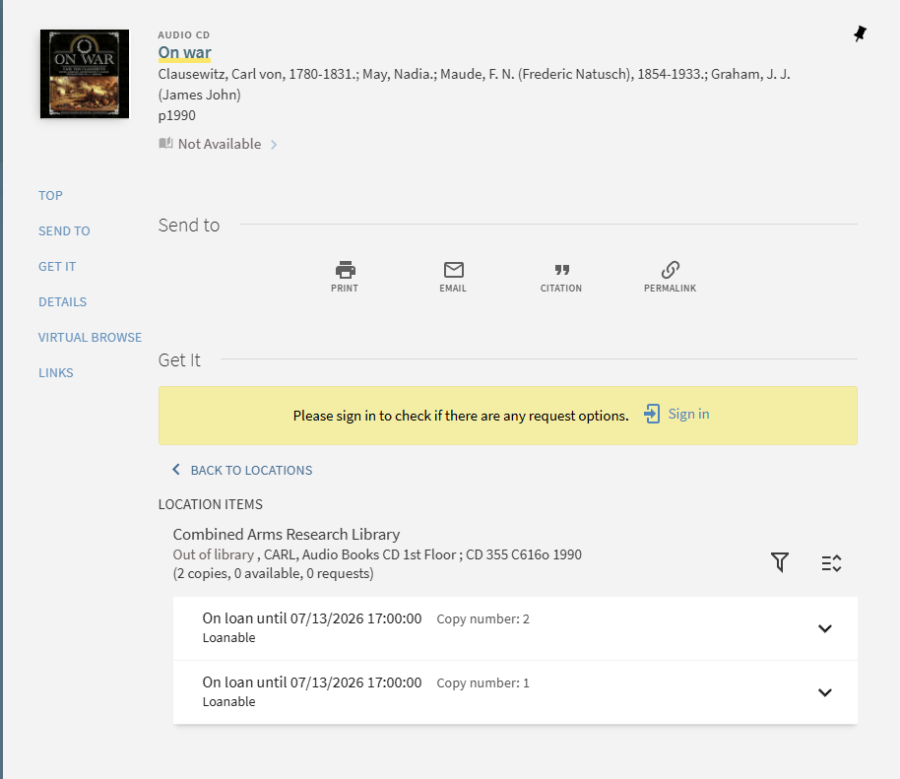
        Search Results
Notes:
To place a request (hold) you will need to sign into your account using your username and password please follow the prompts

Slide 9
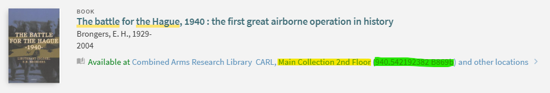
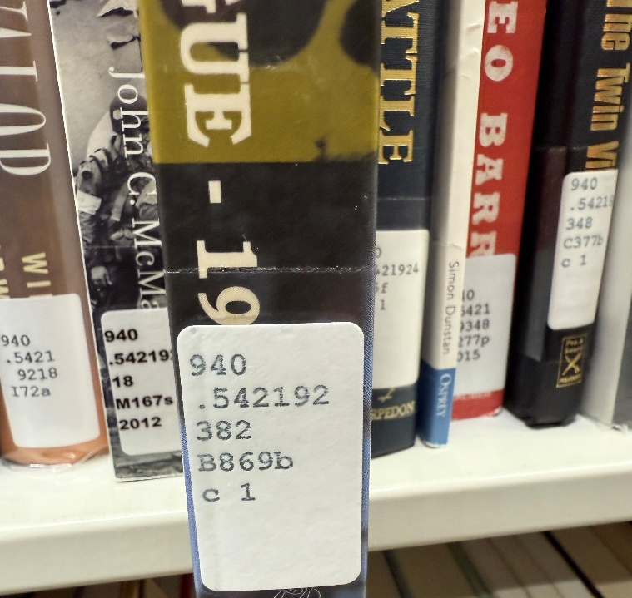
        Finding CARL Materials
LOCATION
CALL NUMBER
940 – history of Europe
940.5 – (history of Europe) 1918 –
940.54 – military history World War II
940.542 – campaigns and battles by theater
940.5421 – European Theater
940.542192 – Netherlands – military history – World War II
940.542192382 – Netherlands – military history – World War II – The Hauge
Notes:
Finding our physical materials. First make sure its available at the CARL, next check for the location (usually has a floor number associated with it) and then the call number (has a bunch of numbers). We use the Dewey decimal system and since Dewey wasn’t a military man, he didn’t leave much room in his numbers for us to get specific. The example here show how if we didn’t add so many numbers all the WWII items would be together and harder for you to browse for other books in your subject.

Slide 10
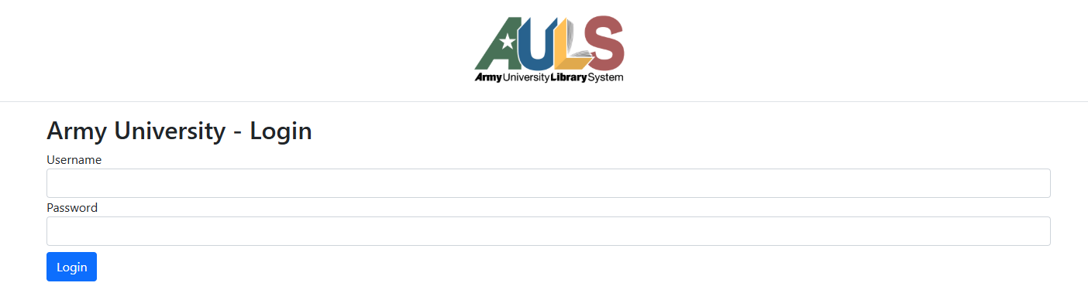
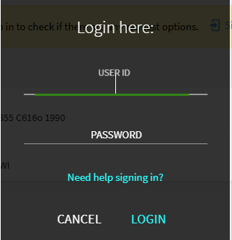
        Logging in
Grants access to CARL e-resources
Notes:
You will be required to log in with your username and password to access your account or access e-resources. Above is one of two prompts you may see. Your username is your library card number (starting in 2169590******) and your password was set up by you. If you are having difficulty logging on please see library staff.

Slide 11
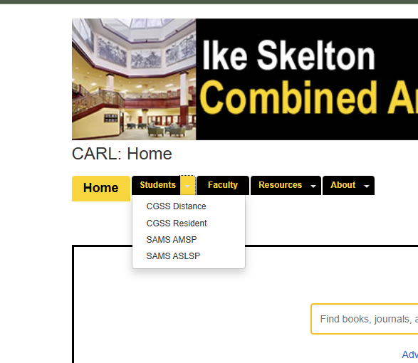
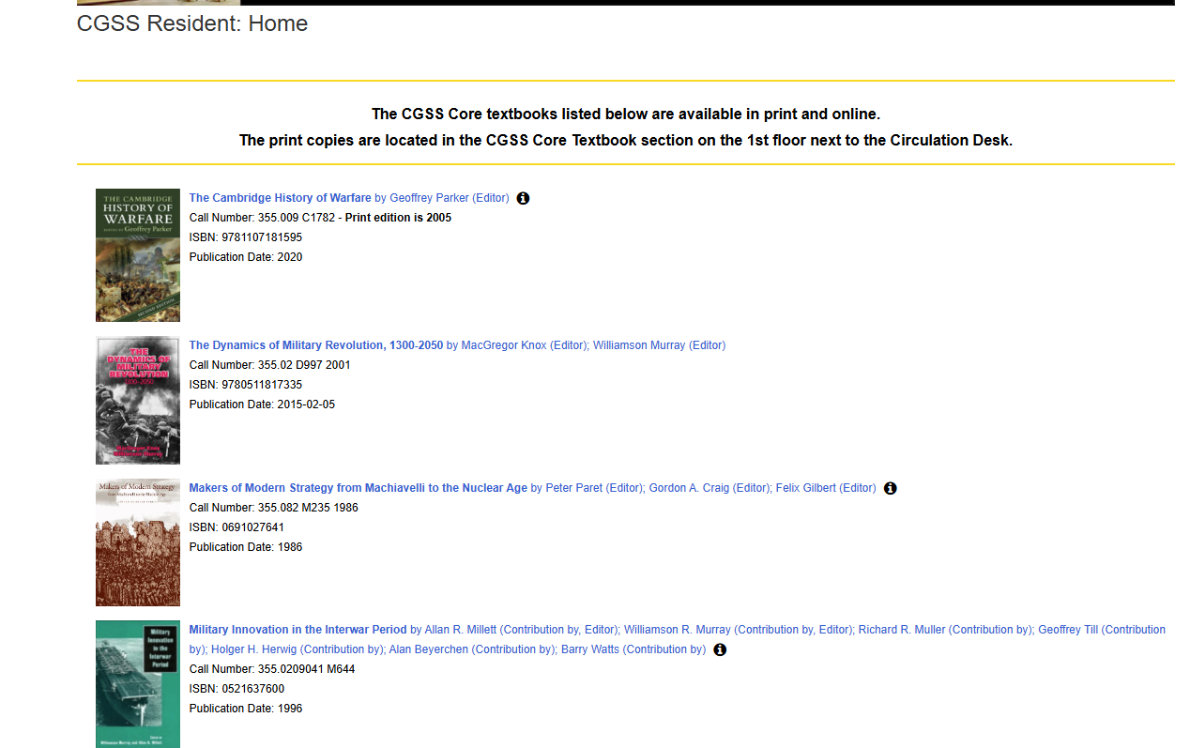
        CGSS Resident Page

Slide 12

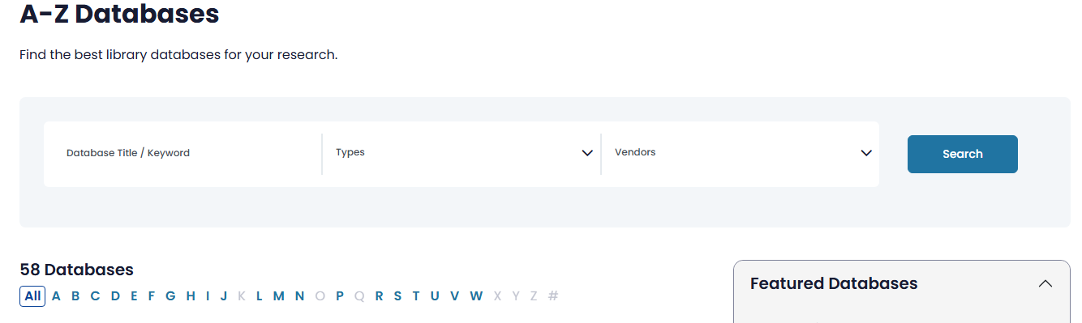
        CARL eResources
Notes:
You can also access our databases through our A to Z list. This is particularly helpful if you aren’t sure which databases you might want to search it. A link to it is provided on our landing page. This is like searching a platform directly, like searching directly in Netflix or Hulu to see what they have playing.

Slide 13




        CARL eResources
Databases:
Digital National Security Archive from ProQuest
ProQuest Military
EBSCO Military/Academic/Business collections
Swank (streaming movies)
Libby (audiobooks)
JSTOR Security Studies and eBooks
JANES
Newspapers:
U.S. Major Dailies (Coverage: 1849-2019)
NewsBank
Newspaper Source Plus
Notes:
CARL offers access to many databases to its patrons, that include database modules from EBSCO, JSTOR, and ProQuest. Some of those databases included provide access to major U.S. news sources, including archives as well as stories from smaller local papers.

Slide 14
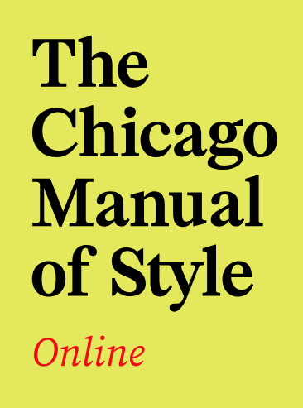
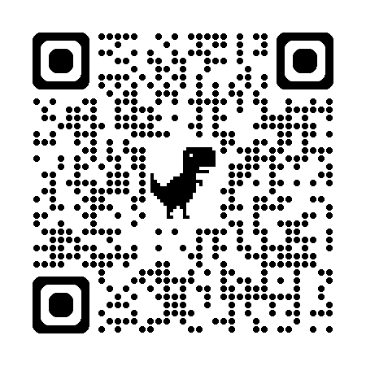
        Citation Resources
Chicago Manual of Style Online
In library copies of print edition
For more citation resources see our guide at
https://carlcgsc.libguides.com/readwritecite
Notes:
CARL offers online access to the Chicago Manual of Style as well as in library use copies of the current edition for your citation information. Please let us know if you have any issues accessing the database.

Slide 15
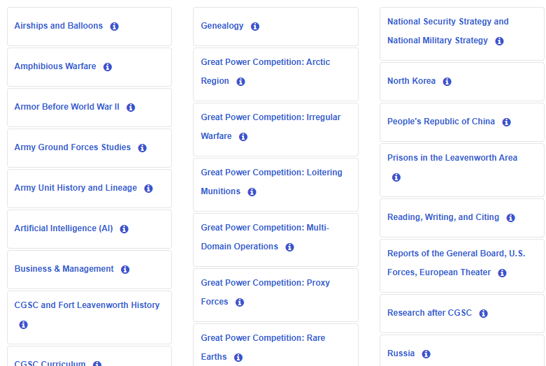
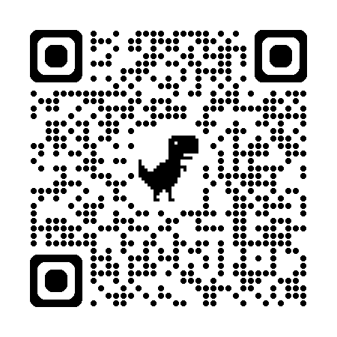
        Subject Guides
Library Subject Guides (LibGuides)
H400
Russia
PRC
Wargaming
And more
Notes:
Subject Guides are starting points for common research topics. Essentially a curated bibliography of resources on a particular topic.

Slide 16
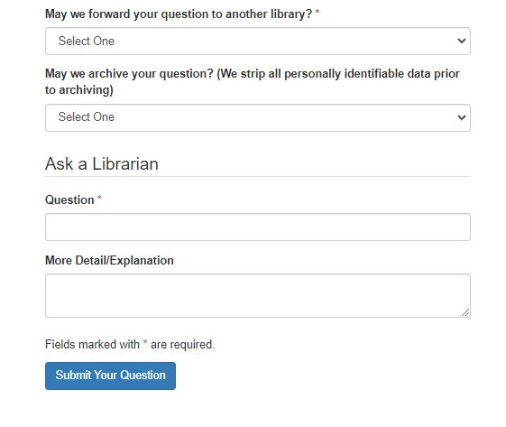

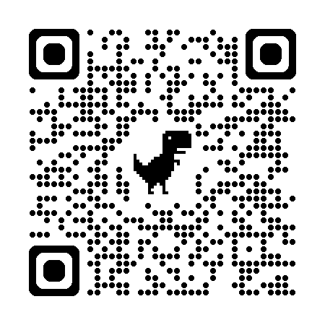
        Ask a Librarian
Easiest way to contact library staff
All questions addressed within 24 to 48 hours
CGSC students have priority
Allows for follow-up with relevant materials and information
Notes:
When you have a question that you just can’t find the answer to or need library assistance-Our Ask a librarian is your best resource. There is also a link on the homepage.

Slide 17
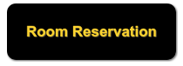
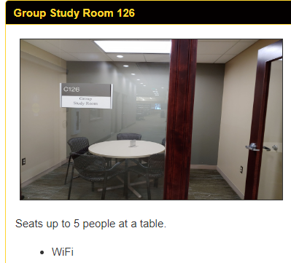
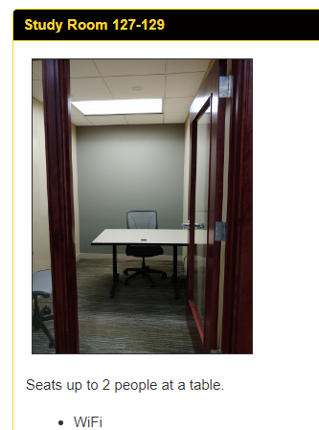
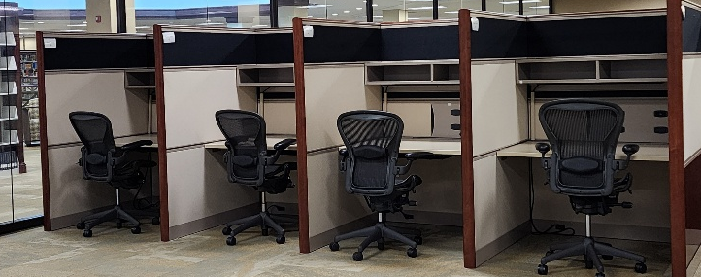
Room Reservations
No same day reservations
Room 126, larger study room with capacity of 5 people
Rooms 127-129, small 2-person study rooms
Study carrels
Larger group spaces for group study and events
Study Carrels 41-44
All day checkouts
Notes:
Room reservations is also located on the home page. We have several different kinds of spaces for several different things. Study rooms check out for 3 hours at a time and reservations must be made 24 hours in advance. Same day is first come first serve. We also for the first time have study carrels available for checkout by the day. If you need a bigger space, please check online or see a library staff member as we have other options as well.

Slide 18
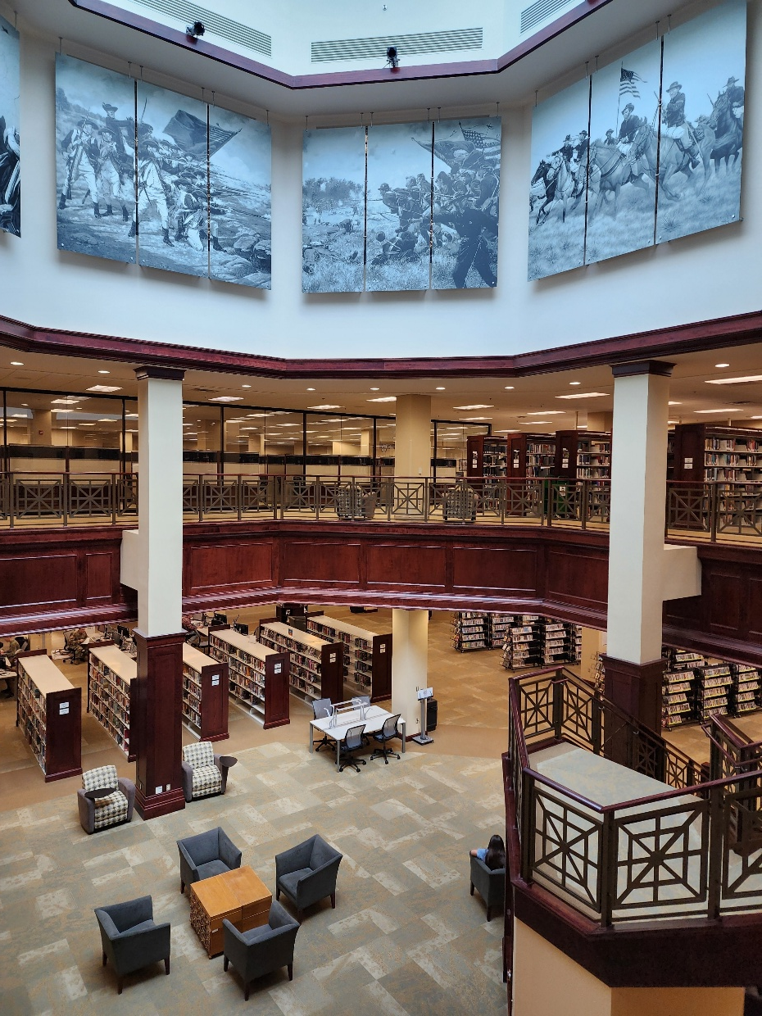
Academic/Study Floor
Second Floor
MAIN Collection
  200,000 non-fiction items
Oversize
  Maps & Atlases
NIPR/AUDS computers
NIPR/AUDS printer
Large wall mounted white boards
100 seats at various tables
Carrels for checkout
  Most reserved for MMAS & SAMS Program
Couch
Vending machines
Notes:
MAIN A non-fiction collection 150000+
Starts 000 and wraps around at 950
Large collection in military 300
Large collection titles in history 900
Oversize collection
Maps, atlases
This is also our quiet study floor
Carrels are reserved for SAMS and later MMAS candiates
100 seats to study plus this lovely couch
Tables have LED lights and power
16 NIPR computers inside the Glass rooms
White Boards
Erased every Friday
Smaller ones available for checkout
Printer
Vending machines
2 sets of stairs
Atrium
Tower (elevator)

Slide 19
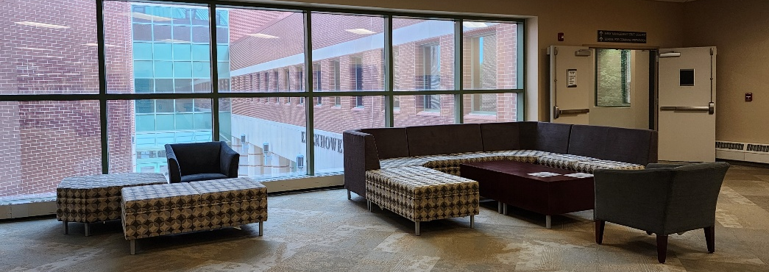
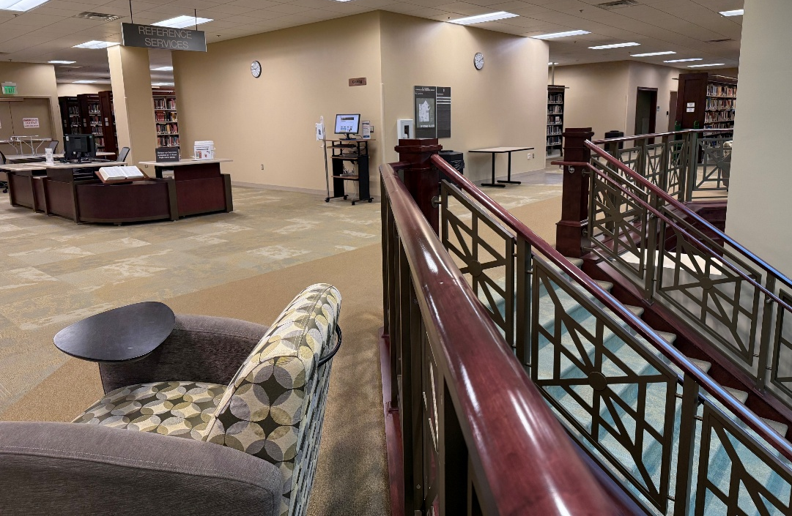
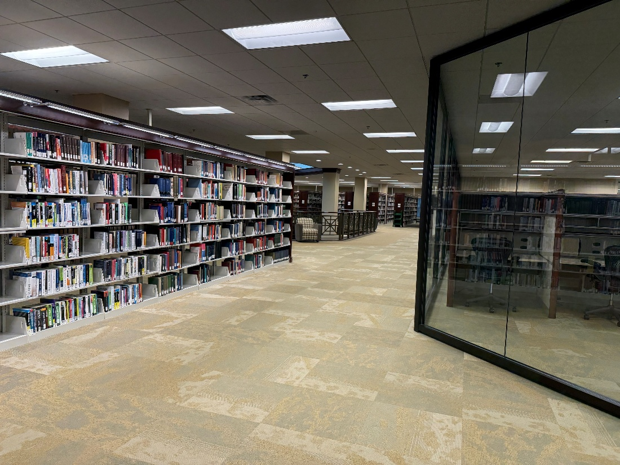
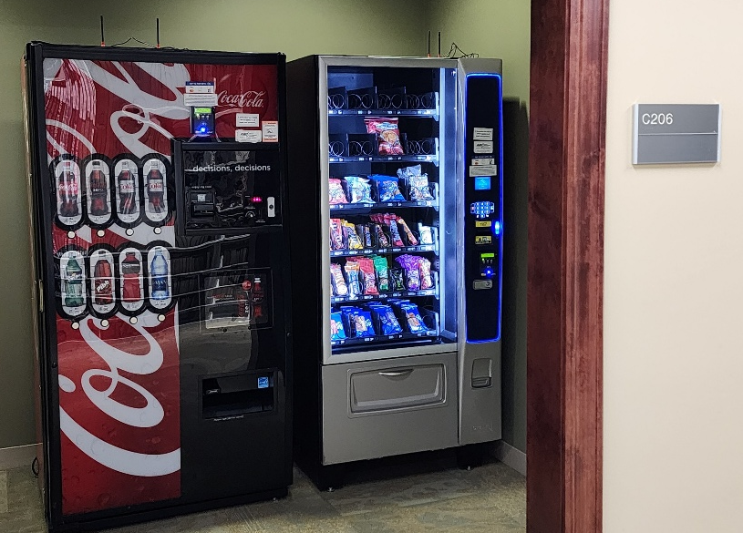
Second Floor
Notes:
When you arrive on the second floor from either the stairs/elevator off the main lobby or the beautiful staircase in the atrium you will find multiple spots to study and relax.

Slide 20
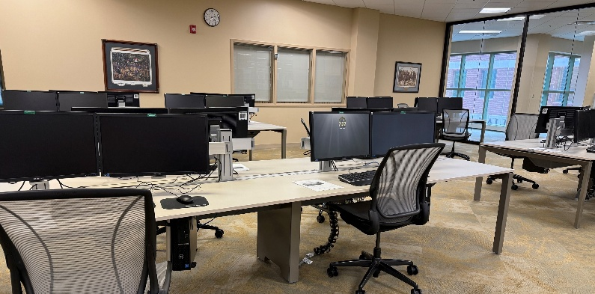
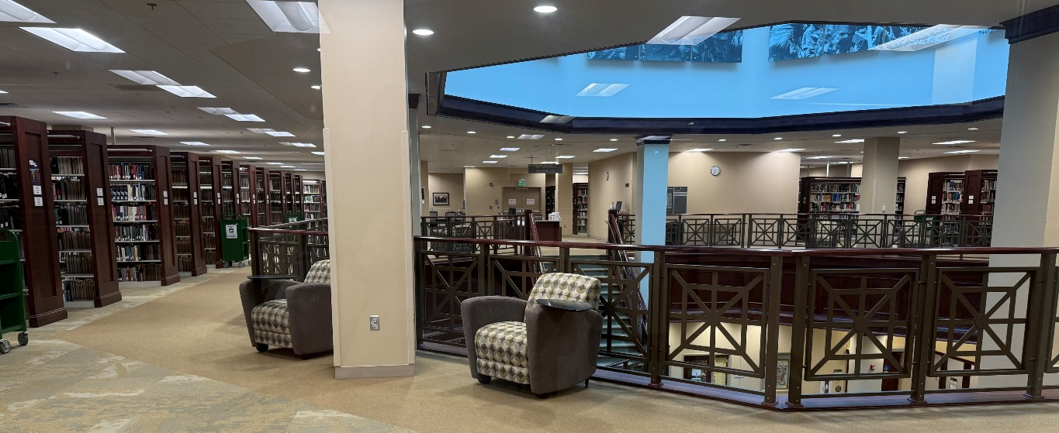
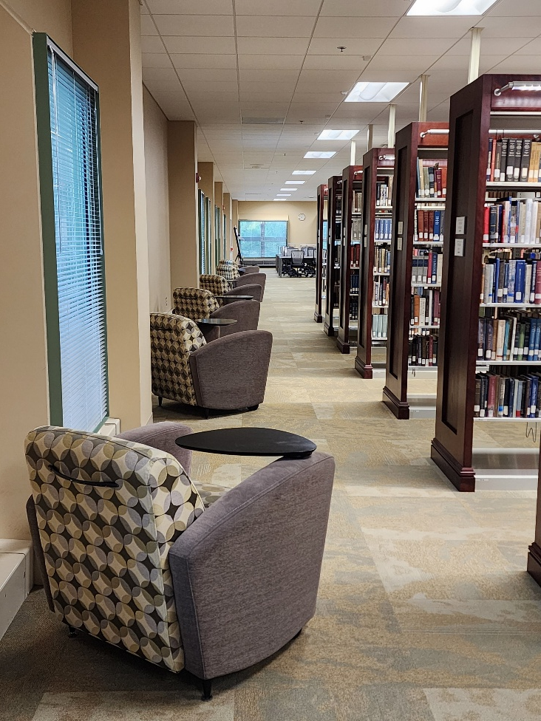
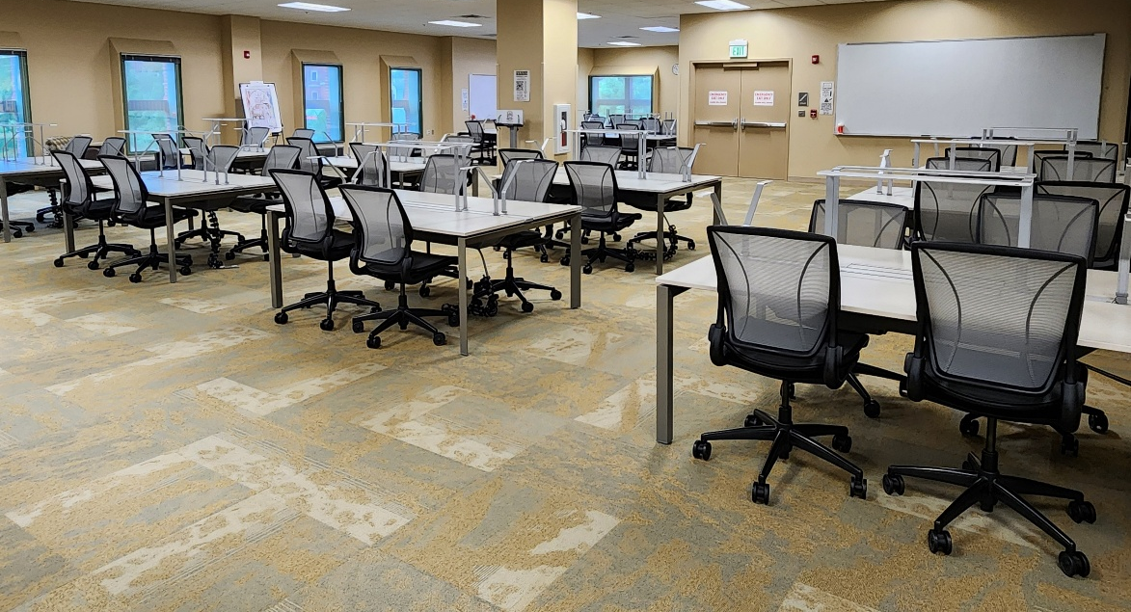
Second Floor
Notes:
Here are some of our second-floor study areas. We have one of the best views of the Buffalo soldier monument and Lake on campus.

Slide 21
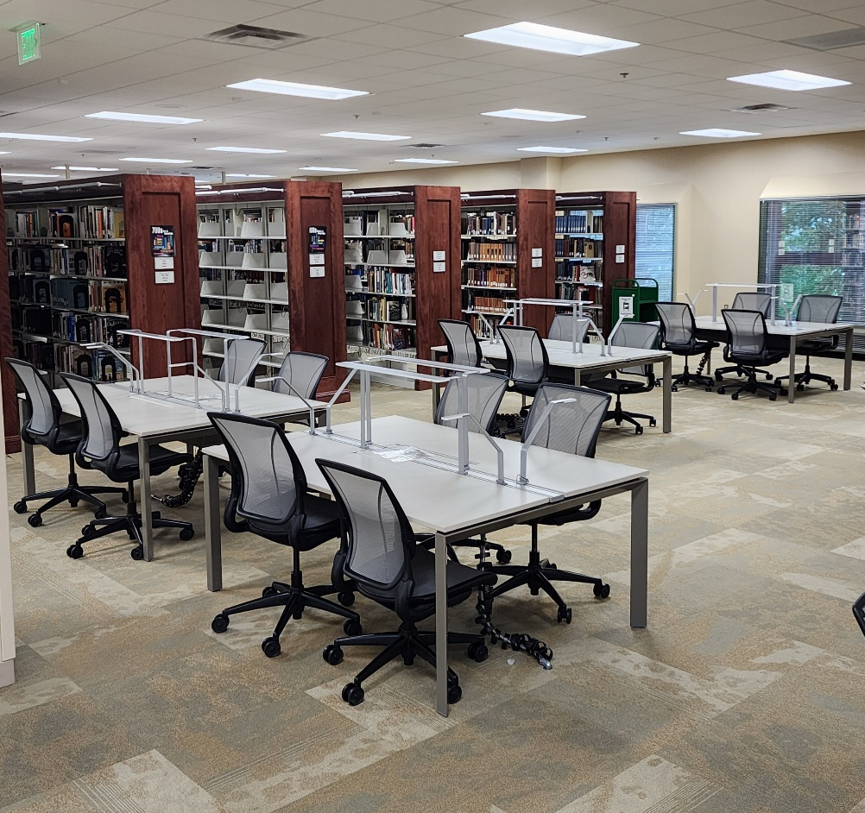
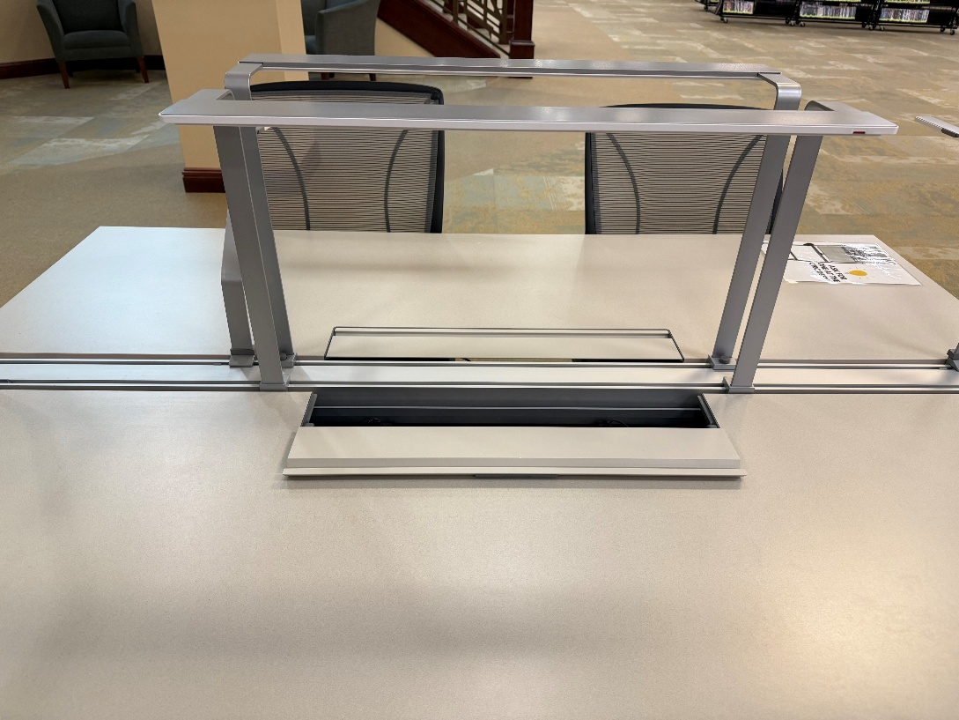
Study Tables
LED lighting
-Small-gray slide
-Large-touch control red
Power for devices
-under sliding compartment

Slide 22
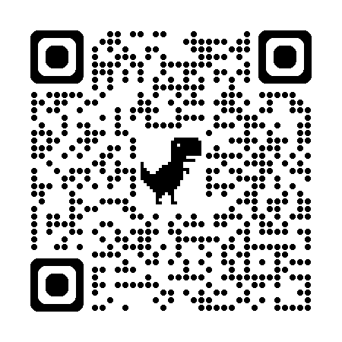
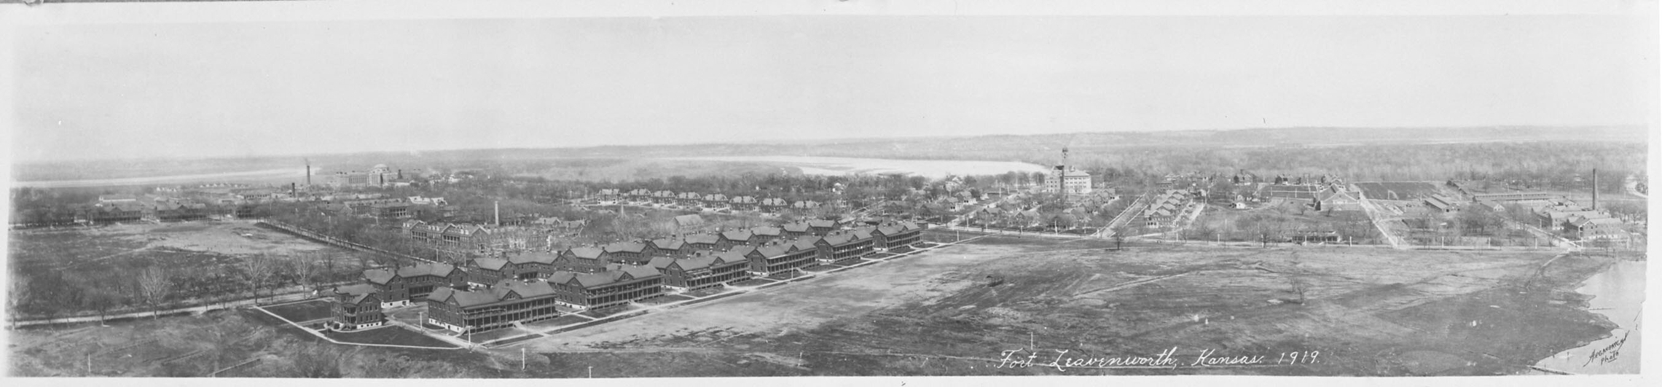
Special Collections
Third Floor
Restricted Access
Archives
Obsolete Publications
Army Documents
Available by appointment, see first floor reference or submit a request on ask a librarian.
Notes:
The Ike Skelton Combined Arms Research Library Special Collections exist to preserve and make available to researchers Command and General Staff College, Fort Leavenworth and other historical materials.
Due to the restricted area in which Special Collections is located, all visiting scholars and researchers must make an appointment to use the archival and special collections and to insure maximum assistance with their research.

Slide 23
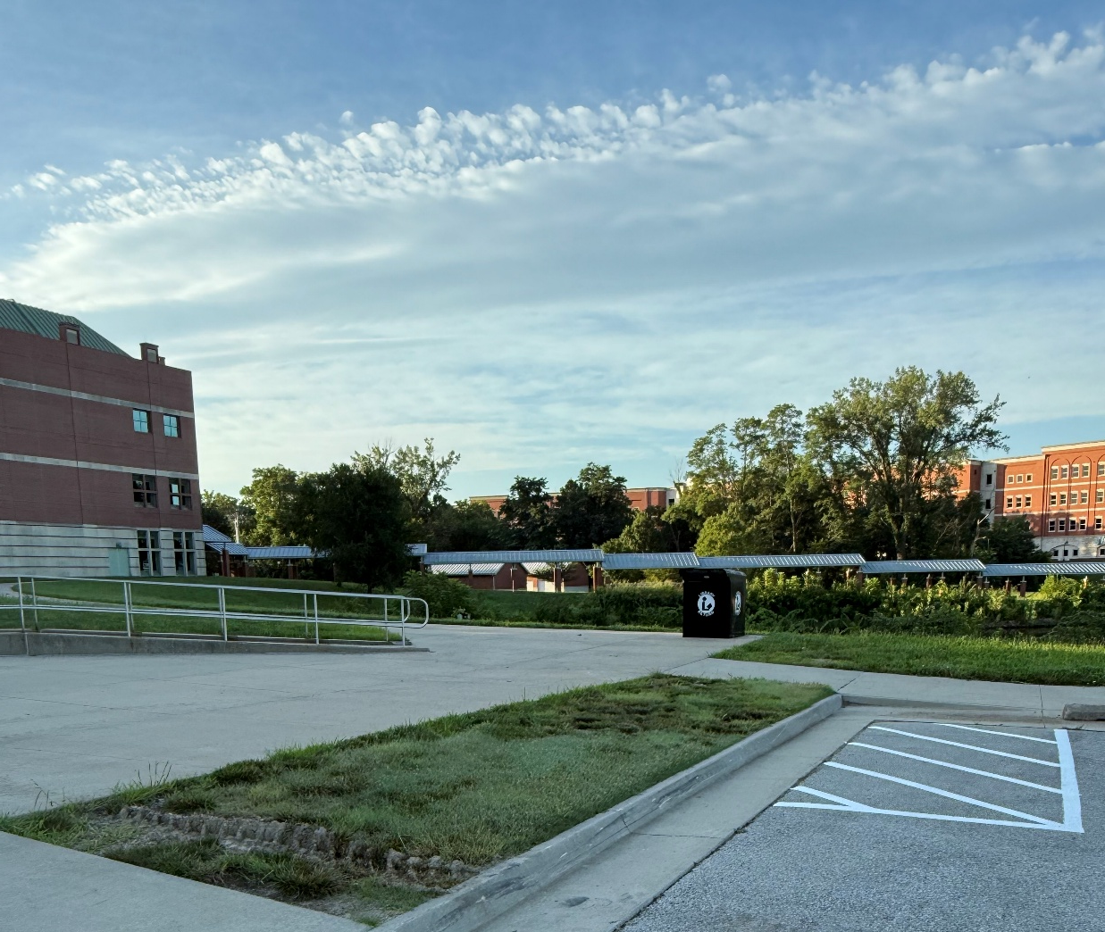
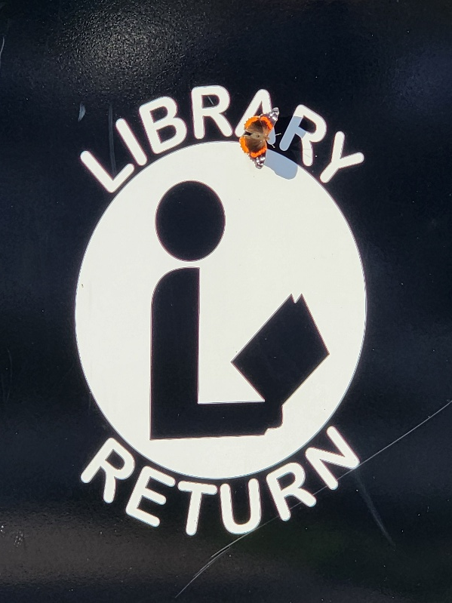
Book Return
Located at the corner of the North parking lot, off Sedgewick by the lake
Notes:
The library has a book drop for you to return materials after hours or if you don’t have time to come in. During extreme weather the book drop may be closed, please check our home page if you are concerned. It is also closed during May so that clearing can occur inside the library.

Slide 24
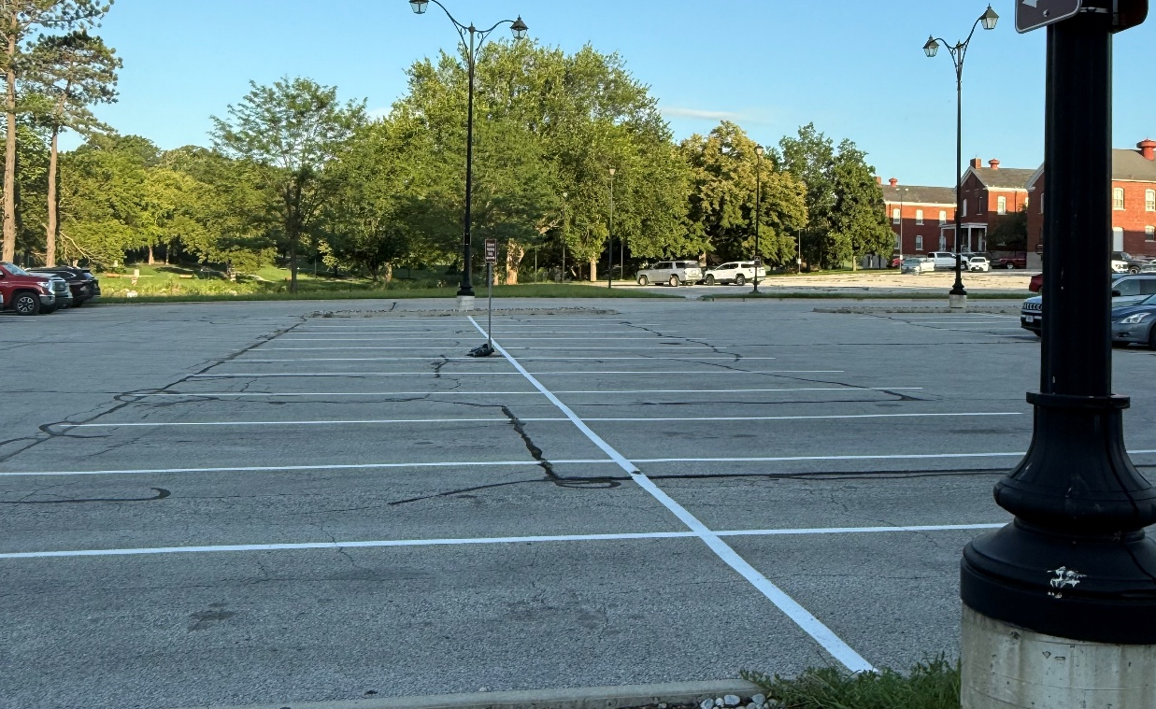
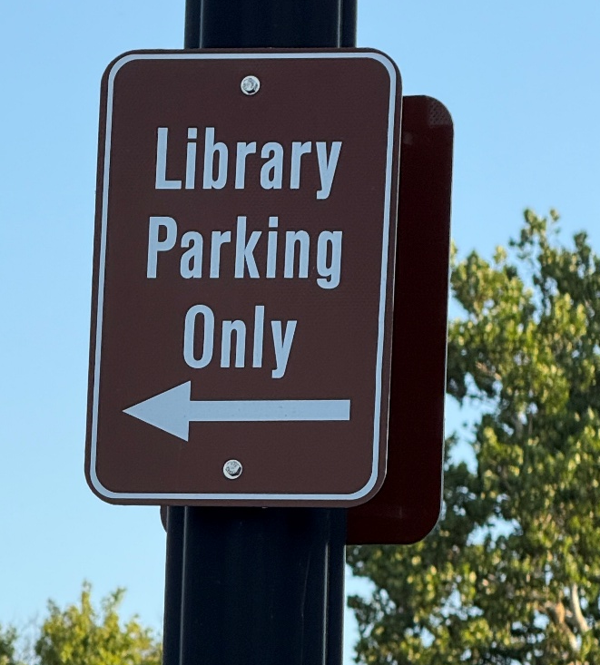
Library Parking
Designated library parking
in parking lot off Sedgewick
first double row
.
Notes:
There is a row of parking just for the library. However, if you park in the library parking when not at the library, don’t expect for there to be library parking for you and your family when you come to the library

Slide 25
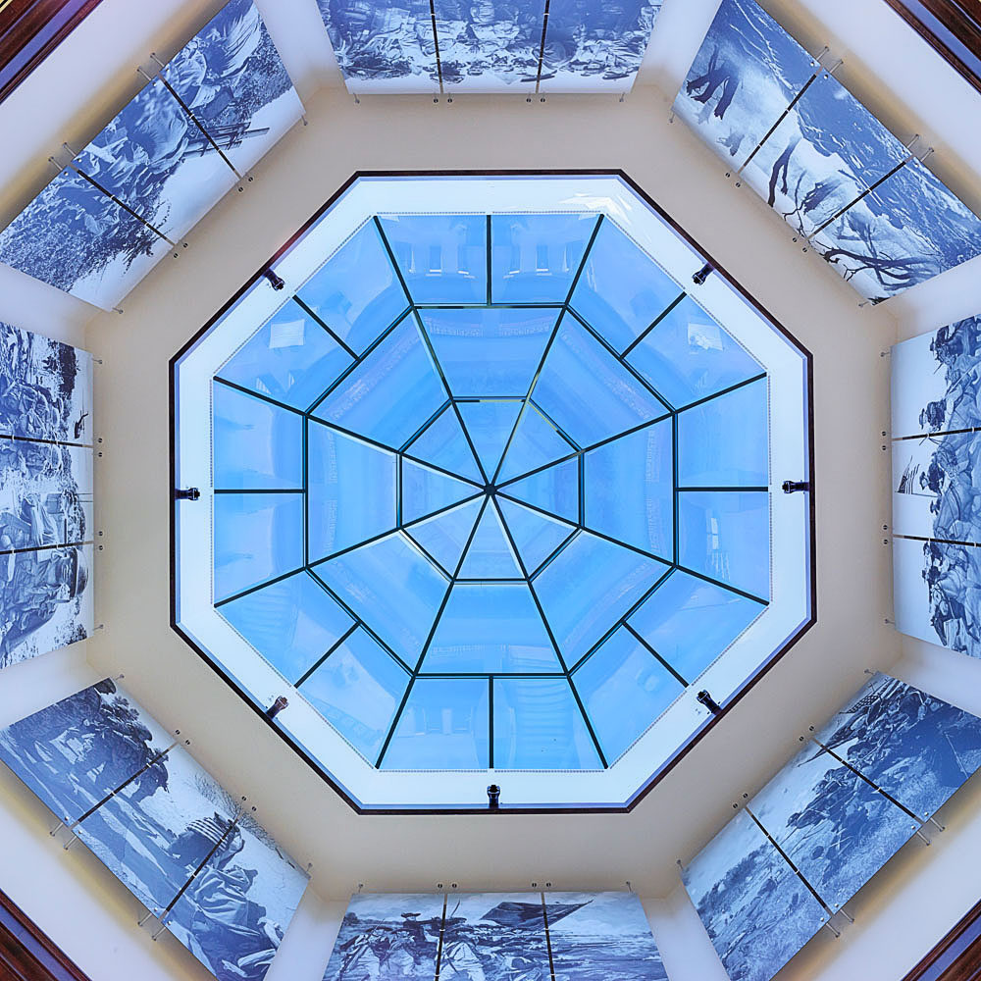
Questions

Slide 26
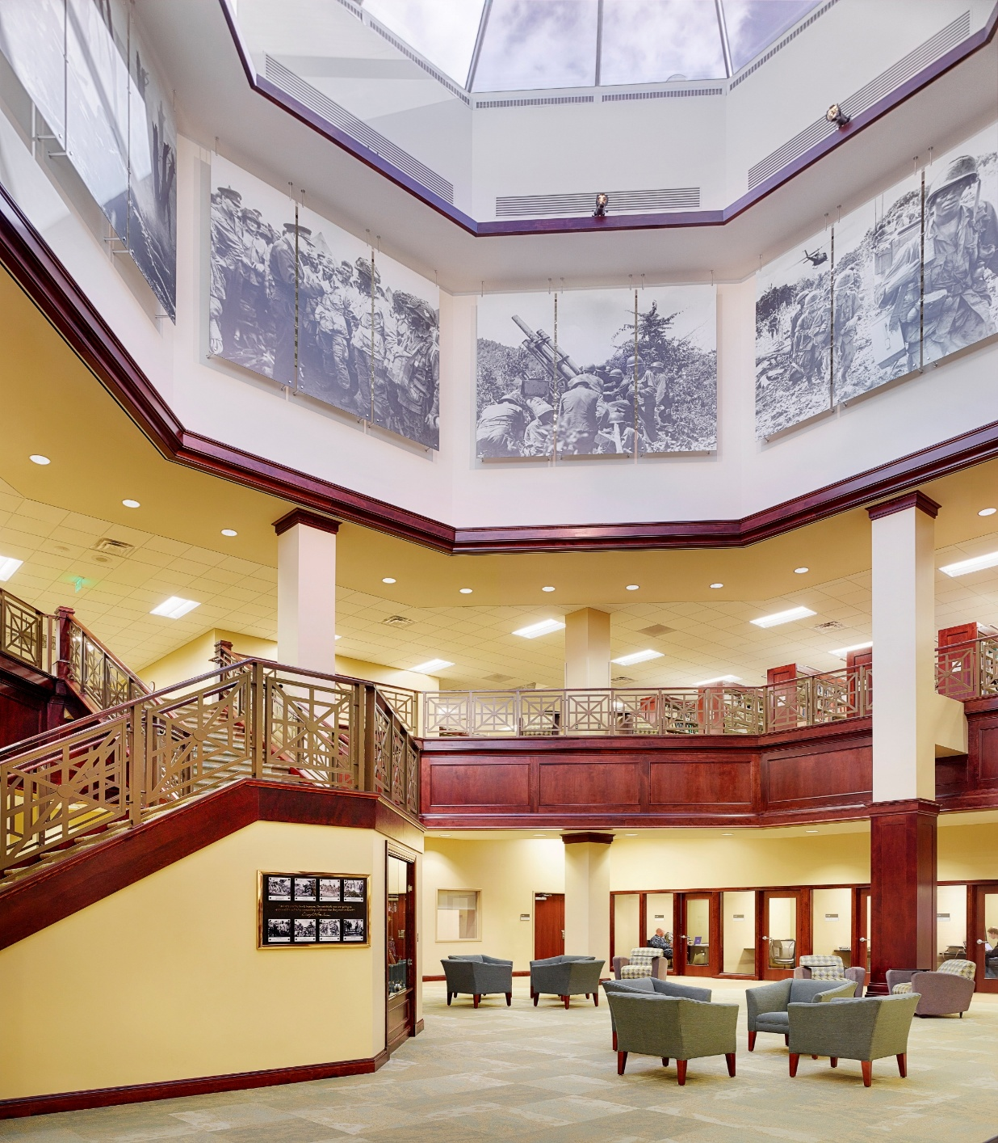
Slides
SGA’s or one staff group representative, if you’d like a copy of the slides, please email us usarmy.leavenworth.au.mbx.cgsc-carl-reference@army.mil or submit an Ask a Librarian.

