Slide 1
CGSC-USSD
S1 In-Brief

Slide 2
USSD S1
Priority of Actions for USSD S1
  Pay impacting: BRS, BAH, FLPB, FSA, etc.
  All absence requests
  Assignments: Processing levy packets, TDY packets, Inter-Post Transfer Assignments, and requests to amend orders.
  Award Recommendations
  Admin Records Corrections: Adding ASI, SQI, assignment history, awards, iPERMS uploads, etc.
  Promotion Certificates
Don’ts
DO NOT contact MPD unless it is for ID card/DEERS assistance. Always contact the S1 first.
DO NOT submit a CRM ticket without contacting the S1 first.
DO NOT contact the Security Manager for OCONUS absences
DO NOT send actions, especially absence requests, directly to me, Mr. Brunner, the XO or the Commander without being instructed to do so.
Absences are submitted to User List: 000000000039481 & User List Type if prompted: Intermediate Approvers.
PARs are submitted to the S1 Pool: 01522472
SMs on a Temporary Assignment should see their unit as Home and USSD as Host. If the PAR will not allow you to select your Home unit, please contact the S1 prior to submitting the PAR.
Comments/More information: Please do not submit an Absence or PAR without additional or amplifying information included in the comments section.
Notes:
According to CAC STB Absence and Pass Policy memorandum dated 4 August 2025, the suspense for an absence request is 15 days prior to the absence date. The suspense for OCONUS and CSP requests is 30 days. Exceptions to this policy, such as Emergency Absence, will be handled on a case-by-case basis.

Slide 3
ABSENCES "QUICK FIRE"
School and the supporting chain of command need to approve ANY absence of class. Absence submitted is not absence approved.
SGAs can approve 2 hours or less of missed class time
TLs can approve 1 day or less of missed class time
Division Directors approve 2 days of missed classes
Director of CGSS approves 3+ days of missed classes
Any submission for leave or pass unless an emergency must be submitted 10 days prior to requested departure.
OCONUS requests, 60 days in advance.
Any missed class must be leave including IPRT days (exception to policy brief in person)
Parental Leave must be submitted and signed before departure (lengthy chain of command process). Can submit for 14 total days with appropriate paperwork, (RFA, Make up plan, ETP, etc.) must be at least 7 days
Absences are submitted through your Team Leader and routed to USSD for approval.
It is YOUR RESPONSIBILITY to ensure your absence request has been approved.

Slide 4
Absences Cont.
Absences
Absence Address: This must be the location where you will be during your absence.
Comments are required
  CGSC AY27 Student: Not missing class or RFA is attached
  MEDPROS: State current medical readiness (Green, Amber, or Red). If Amber or Red state the date you are taking care of the deficiency.
  State that you informed your SGA and/or Team Leader and that they are aware of your travel. If the absence address is a local address, you must state that you are remaining local during your absence.
  Mode of Transportation: State how you will travel (flying or driving) to the address you will be at during the absence.
  Local absences: “I will remain local for this absence.”
Attachments
  Missing Class: Approved Request for Absence (RFA) form, Exception to Policy (if applicable)
  MEDPROS: required to verify Medical Readiness
  Birth certificate: this is only required for Parental leave
  OCONUS leave: RFA/RMUC if required, IATP for PACOM travel, approved APACS request, SERE and AT Level 1 Training Certificate, Theater AOR (Memorandum), Report of Foreign Travel (Memorandum), and Foreign Travel Briefing

Slide 5
OCONUS ABSENCES
OCONUS Leave
All required documents must be complete, current, and attached to the IPPS-A absence request. Submit OCONUS requests at least 60 days in advance.
Officers must check for APACS and TT/IATP requirements for the destination at https://www.fcg.pentagon.mil/fcg.cfm
TT/IATP can be completed at: https://iatp.pacom.mil
  O-5 Approval Authority is USSD CDR, LTC Goldman
  O-6 Approval Authority is CGSS Director, COL Ikena
APACS can be completed at: https://apacs.milcloud.mil/apacs/
***Contact USSD first for any questions related to OCONUS travel!
Required Documents
AT Level 1
SERE Completion Certificate
AOR Threat Brief MFR
Report of Foreign Travel Form
TT/IATP Summary (when required)
APACS Approval (when required)
RFA if missing instruction hours
Academic Make-up Plan/RMUC
ETP if Required
Notes:
This is under normal conditions. Previous slide gives you the current authorization levels.

Slide 6
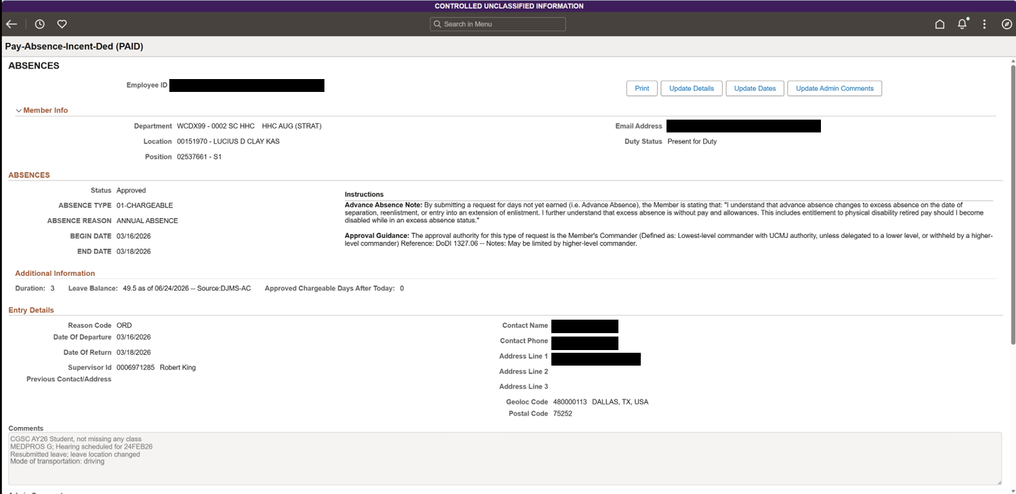
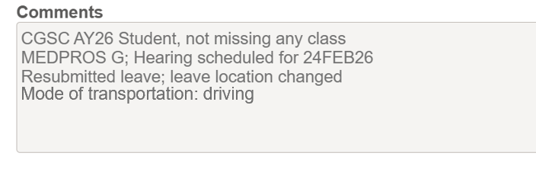
Absence Comments
SGA is aware of this absence
Local absences need to state: “I will remain local for this absence.”

Slide 7
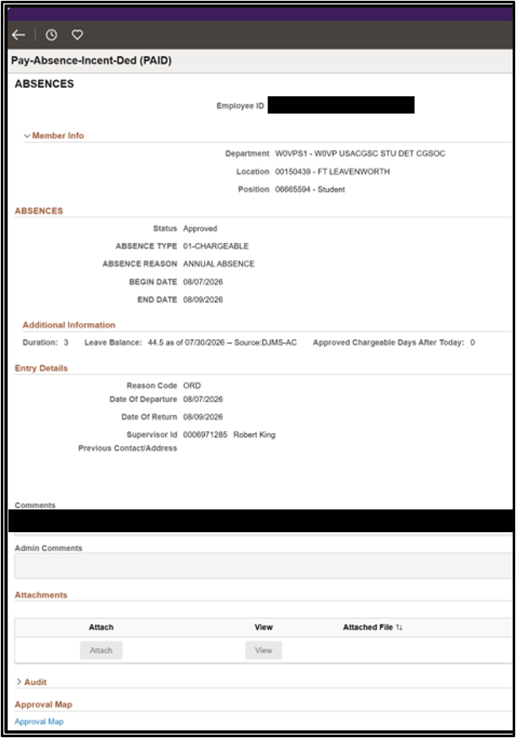
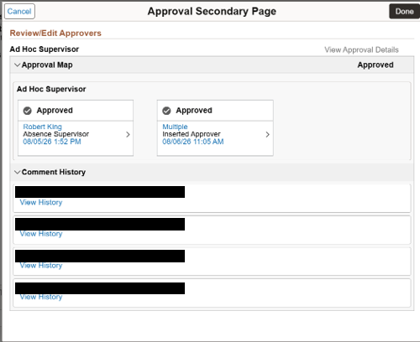
Finding Comments

Slide 8
USSD S1
PAID Actions
BAH Recertification
Family Separation Allowance (FSA) – FSA-R (Active Duty)
FSA-T (Guard and Reserve
PARs
Basic Allowance for Housing (BAH) Change – Required documents: DA Form 5960, Marriage certificate or dependent birth certificate, orders assigning you to Fort Leavenworth
Blended Retirement System (BRS) Continuation Pay
Family Separation Housing Allowance - BAH (Dual BAH for RA/RC with and without dependents)
Foreign Language Proficiency Bonus (FLPB)
Admin Records Correction
Qualifications and Skills
iPERMS updates
Periodic Records Review (PRR)
DD93
SGLI
Assignments
CONUS
OCONUS
Disapproved Actions - All PARs will contain comments to the SM in the Approval Chain
All Absences will contain comments to the SM in the Approval Map
Notes:
For BRS be cautious of your PEBD. For CY 26, which end on 31 December, your window is 7-12 years, but on 1 January for CY 27 that window shrinks to 7-10 years. For anyone that served in the Reserves prior to the Active Army your PEBD started when you entered the Reserves and you window is still 7-12 years from your PEBD for CY 26.
https://myarmybenefits.us.army.mil/Benefit-Library/Federal-Benefits/Continuation-Pay

Slide 9

Questions
S1 Information
Phone: 913-684-7328 or on Teams 520-725-2593
Email: robert.j.king78.civ@army.mil
Fax machine: 913-684-4411
Hours of operation: 0730 – 1500

