Slide 1
US Student Detachment Orientation
Command and General Staff School Class AY27
As of 01 APR 22

Slide 2
USSD MISSION
The U.S. Student Detachment (USSD) provides command, administration, training, and UCMJ support to assigned and attached students to allow the Command and General Staff College to educate, train and develop leaders for Multi-Domain Operations (MDO) and Joint All-Domain Operations (JADO) in a joint, interagency, intergovernmental, and multinational (JIIM) operational environment; and to advance the art and science of the Profession of Arms in support of Army operational requirements.
Key Tasks:
Conduct administrative and AR 600-20 support for CGSC assigned Soldiers
Ensure CGSC assigned personnel are administratively, medically, and physically ready
Support CGSC Soldiers, Families, and the Community
Manage high risk Soldiers for Special Troops Battalion

Slide 3
WHAT WE DO FOR YOU
Administrative
  In/out processing
  Leave/ Pass / TDY
  Finance/MPD – USSD is the representative for the student body
  Referral Services
  Awards
Medical
  MEDPROS (PHA, Dental), Temp Profile Review Board (180+)
  PEBLO/IDES
  Tracking, Action Plans (Munson, BH, SJA, SUDCC)
Physical
  AFT Testing & Standardization
  HT/WT Screening
Legal
  UCMJ/Administration Actions
  Flagging Actions, Separations, and course removal

Slide 4
USSD ORGANIZATION
CGSS Director
COL Rich Ikena
Deputy
Mr. Tom Duncan
Commander, USSD
LTC Amanda Goldman
Deputy to the Commander, USSD
Mr. Ty Bruner
USSD XO
MAJ Mike Crooks
Education Tech Staffing Directives
Mr. Brandon Ohmie
S1 / Human Resource Specialist (Mil)
Mr. Bob King
Notes:
Just wanted you to understand there is not a huge staff here to assist you. We will however provide you with great service. Also keep in mind with a small staff the procedures that are in place are to ensure we can give you great service.

Slide 5
CGSOC AY27
Component | #
Regular Army | 736
Army National Guard | 60
Army Reserve | 60
Air Force | 67
Space Force | 5
Navy | 11
Marines | 23
Coast Guard | 1
Inter-Agency / DA Civilians | 4
International Military (IMS) | 87
Total | 1054

Slide 6
CGSC IMPORTANT DATES
1. Spouse Panel
  11 AUG (1800-2000) L&CC Eisenhower Auditorium
2. SGA Time (First Time in Classroom); all students
  13 AUG (0830-1520) Various Classrooms
3. CGSC Student Leadership Seminar; all Class/Section/SG leadership positions
  14 AUG (0800-0830) Arnold Conference Room
4. Flag Day Rehearsal; International Students and Class President ONLY
  14 AUG (1330-1530) L&CC Eisenhower Auditorium
5. Flag Day Ceremony
  17 AUG (1030-1130) L&CC Eisenhower Auditorium
6. CAC Commander’s Opening Remarks
  17 AUG (1300-1400) L&CC Eisenhower Auditorium
Notes:
Uniform is ASU/AGSU’s Ike Jacket authorized.

Slide 7
STAFF GROUP ADVISORS
Advisor, Counselor, Evaluator, Coach
Provides counseling to students on personal and professional goals and academic progress
Assists the staff group in setting group goals
Authorizes student absences up to 2 hours (unless 2 hours is a full day)
Maintains and writes evaluation reports
Provides input to selection boards and special programs (SAMS, Scholars)
Nominates students for end of year awards
Completes AER at the end of the course
This is the go-to person when you don’t know what to do next!

Slide 8
WHAT TO EXPECT
Productive year for professional growth.
Time with family.
Demanding curriculum. Plan and manage your time.
Changes to the schedule occur. Pay attention to the calendar and changes from your SGA.
There are limited training holidays in conjunction with federal holidays .
Class will not always end at the same time.

Slide 9
GUEST SPEAKER PROTOCOL
Two Buzzers will sound
    First one; take your seats
    Second; quiet, listen, enjoy
    Stand after introduction of guest speaker
When asking a question
    Stand, state your rank, name, and staff group (Nearest microphone)
    Example – Sir/Ma’am, MAJ John Smith, Staff Group 8B
DO ASK QUESTIONS! – questions should be thought provoking, insightful and relevant to their current roles.
DO NOT ASK MULTIPLE PART QUESTIONS
DO NOT bring drinks, food or bags in Auditoriums or leave them outside in any space. This is a security violation. (Utilize assigned lockers or leave in classroom)

Slide 10
FITNESS STANDARDS
MUST PASS AN AFT TO GRADUATE
  Combat arms officers must achieve a minimum score of 350 with 60 points in each event
  Non-combat arms officers must achieve a minimum score of 300 with 60 points in each event
Students are responsible for their own Physical Fitness.
  2 x AFTs; possible diagnostic CFT
  2 x WHtR screenings & BF Assessments
All profiles must be reviewed by the CGSS Surgeon Cell.
The APFU is the ONLY authorized duty uniform for the AFT and WHtR screenings.

Slide 11
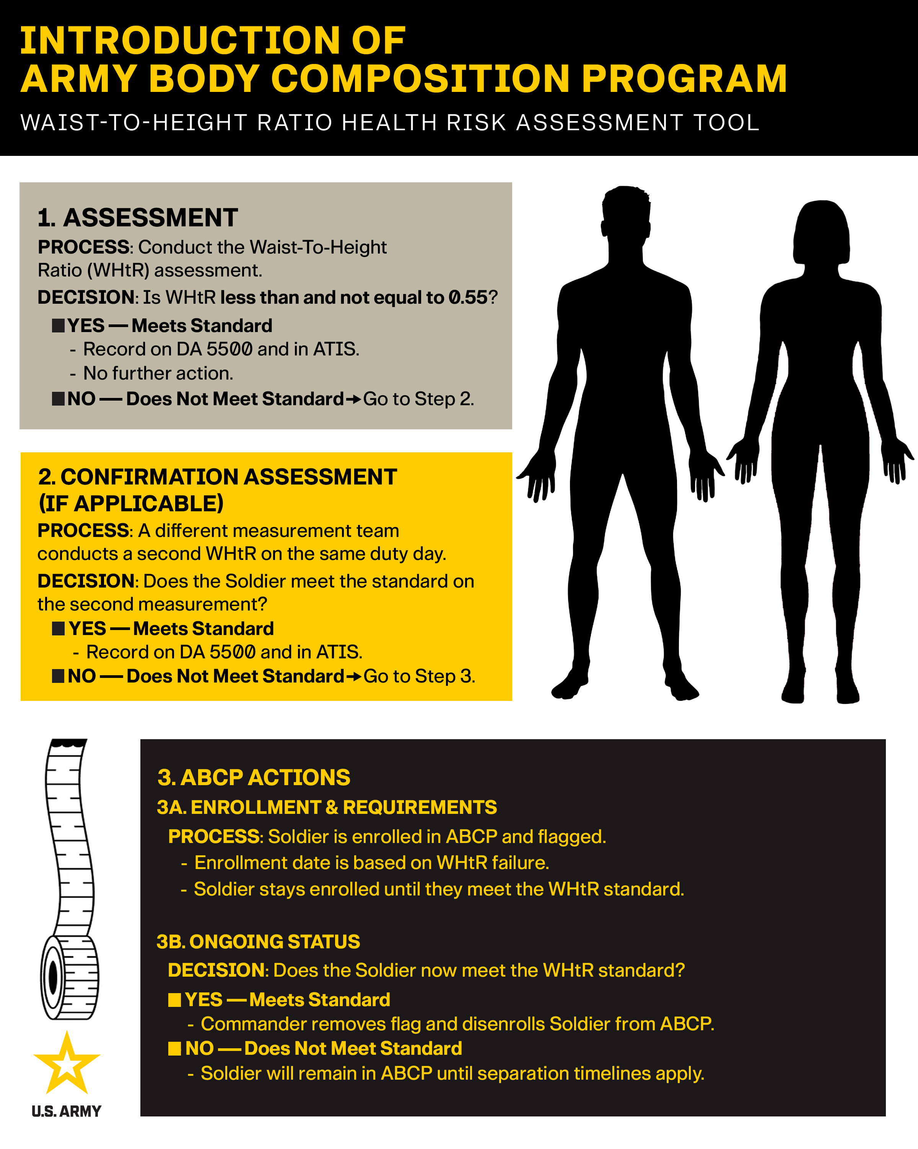
BODY COMPOSITION STANDARDS
Army Directive 2026-13 (Army Body Composition Program and Standards) aligns the Army Body Composition Program (ABCP) with medically validated, streamlined approaches to promote consistency, fairness and the overall health of the joint force.
The directive establishes the waist-to-height ratio (WHtR) as the Army's sole body composition assessment.
The WHtR screening replaces the height and weight tables previously used to screen Soldiers.
The new body composition standard is a WHtR of less than, but not equal to 0.55. It is recorded to a precision of three decimal places. The WHtR will not be rounded, and any subsequent digits after the third decimal place will be disregarded (.549 is a passing score; .550 is a failing score).
All Soldiers will be screened at least twice per calendar year.

Slide 12
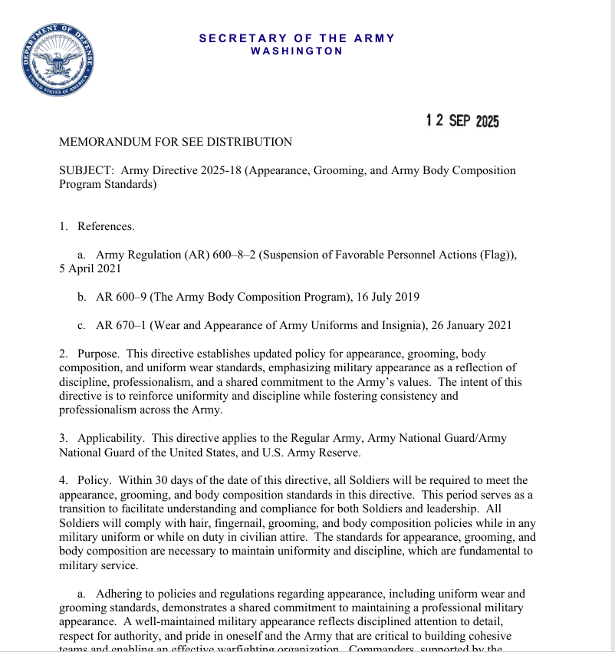
ARMY DIRECTIVE 2025-18
“Within 30 days of the date of this directive (published 12 SEP 2025), all Soldiers will be required to meet the appearance, grooming, and body composition standards in this directive. This period serves as a transition to facilitate understanding and compliance for both Soldiers and leadership. All Soldiers will comply with hair, fingernail, grooming, and body composition policies while in any military uniform or while on duty in civilian attire. “

Slide 13
UNIFORMS
You will need your dress uniform multiple times throughout the year. Keep it ready.
While in the building you should always be in uniform. This is a high profile and frequently visited facility. It is not uncommon for multiple GO's to be present. You could run into your future BN, BDE, or Division Commander.
APFU will be required at times.
Civilian business attire might be prescribed during the warfighter phase.
***Ensure that you are in compliance with AR 670-1 uniform standards at all times.

Slide 14
ENFORCING STANDARDS
“Adhering to policies and regulations regarding appearance, including uniform wear and grooming standards, demonstrates a shared commitment to maintaining a professional military appearance. A well-maintained military appearance reflects disciplined attention to detail, respect for authority, and pride in oneself and the Army that are critical to building cohesive teams and enabling an effective warfighting organization. Commanders, supported by the noncommissioned officer support chain, will enforce the standards prescribed in enclosure 1 (Personal Appearance Policies) and enclosure 2 (Wear of Army Uniforms and Insignia Standards) to this directive. Maintaining unit cohesion and discipline is paramount, and any Soldier can address a situation that warrants an on-the-spot-correction to uphold these standards.”
Army Directive 2025-18

Slide 15
GROOMING STANDARDS
Mens Hairstyle
  must blend evenly around the sides and back and will not fall over the ears.
  bulk (distance the hair protrudes from the scalp) of the hair at the top of the scalp will not exceed 2 inches, and the bulk of the hair at the sides of the head will not exceed 1 inch.
  Sideburns will be trimmed to above the opening of the ear canal (AD 2026-09)
  mustaches neatly trimmed, tapered, and tidy. Mustaches will not present a chopped off or bushy appearance, and no portion of the mustache will cover the upper lip line, extend sideways beyond a vertical line drawn upward from the corners of the mouth (AR 670-1)

Slide 16
FEMALE HAIR STANDARDS
  Bangs must remain above the eyebrows when worn and, at a minimum, be no shorter than the middle of the forehead.
  Buns will be worn on the back of the head and may extend a maximum of 3 inches from the scalp and no wider than the width of the head. Centered, and in line with the top of the ears
  Ponytails. OCP or APFU, The bulk of the ponytail must not exceed the width of the head. length must not exceed 6 inches from the top of the collar. The minimum length is at least 1 inch, measured from the base of the ponytail holder.
  Maximum of two braids (must run down the center of the back, parallel to each other and in equal length and width), with no braid exceeding 2 inches in width, and no longer than 6 inches when measured from the top of the collar.
  Hair Color. Must present a professional and natural appearance (any shade of hair that grows from the scalp without artificial coloring). Must be applied in a blended, subtle manner. Abrupt or extreme artificial contrasts in shading are not authorized.
  Devices. Hair holding devices used to secure hair will closely match the Soldier’s hair color. Should be discreet and be no larger than ½ inch thick. Scrunchies, barrettes, pins, clips, rubber bands, and hair or head bands are authorized if they conform to the natural shape of the head.

Slide 17
GROOMING STANDARDS
  Fingernails. Males not authorized fingernail polish and must be kept no longer than the tip of the finger. Females authorized only clear nail polish. Nails will not exceed ¼ inch length from tip of finger.
  Cosmetics. Not authorized for males. Females may wear if it is applied in a conservative manner and maintains a professional and uniform appearance. It may not enhance or alter facial features by adding color that does not match natural complexion. Lip stick and lip liner are not authorized
  Eyelashes. Eyelash extensions of any kind are not authorized.
  Earrings. Males not authorized. Females can wear in service and dress uniform (not APFU). Worn as a single pair of matching posts, in standard earlobe, not to exceed ¼ inch. May be gold, silver, clear, diamond, pearl
  Maximum of two braids (must run down the center of the back, parallel to each other and in equal length and width), with no braid exceeding 2 inches in width, and no longer than 6 inches when measured from the top of the collar.
  No braided or unbraided ponytails when in any variation of the dress uniform. Hair must be styled above the collar or secured in a bun above the collar when in service or dress uniform variations.

Slide 18
GROOMING STANDARDS
  OCP:
    CAC patch
    No cuffed sleeves
  AGSU
    Shined shoes
    CAC Patch
    No braided or unbraided ponytails when in any variation of the dress uniform. Hair must be styled above the collar or secured in a bun above the collar when in service or dress uniform variations
  APFU:
    Army Issued
    Socks must be solid black or white, covering the ankle bone, no logos
    PT Belt not required unless conducting PT
    Braces/devices must be annotated on a profile

Slide 19
ACCOUNTABILITY
Common Core/AOC
Accountability within staff groups every duty day.
Duty days in which students are authorized to be outside the Lewis and Clark Center IAW the academic schedule (e.g. IPRT days, X100/X200 Weeks), staff groups will conduct accountability and submit reports to their Teams.
During holiday breaks, students not on a leave/TDY status must report for to their Teams or assigned cadre member.
Warfighting Applications (WA)
Beginning 30 days prior to Term 1 of WAs, individual accountability will be conducted each duty day NLT 0830 using the Student Accountability Tracker System (SATS). It is provided via Canvas as a test/quiz.
Students will meet in their assigned staff groups for SGA Time ("homerooms") on the first duty day of each week. This is a mandatory meeting and provides time for staff group coordination, information exchange, and accountability.
Notes:
Student Accountability Tracker is here as a means of accounting for each of you.

Slide 20
ABSENCES
Absences
  Requests submitted via IPPS-A to Team Leader with ALL COMPLETED required paperwork
  Approved request required for:
    missed class time
    travel > 350 miles
    > 24 hours spent outside of residence
  Passes not granted during duty days; must coincide with a weekend or federal holiday. Comments should reflect “Not missing any class”.
Emergency / urgent leave: goal is to expeditiously and safely allow a student to tend to urgent family matters
  These requests may receive VOCO approval with follow on paperwork.
DO NOT BUY TICKETS FOR ANY TRAVEL UNTIL YOU HAVE AN APPROVED ABSENCE REQUEST
COORDINATE WITH YOUR SMALL GROUP ADJUTANT FOR ALL LEAVE AND PASS QUESTIONS
ABSENCES FOR USMA CLASS REUNIONS WILL NOT BE GRANTED DURING THE DUTY WEEK
Notes:
This is under normal conditions. Previous slide gives you the current authorization levels.

Slide 21
ABSENCES "QUICK FIRE"
School and the supporting chain of command need to approve ANY absence of class. Absence submitted is not absence approved.
SGAs can approve 2 hours or less of missed class time
TLs can approve 1 day or less of missed class time
Division Directors approve 2 days of missed classes
Director of CGSS approves 3+ days of missed classes
Any submission for leave or pass unless an emergency must be submitted 10 days prior to requested departure.
OCONUS requests, 60 days in advance.
Any missed class must be leave including IPRT days (exception to policy brief in person)
Parental Leave must be submitted and signed before departure (lengthy chain of command process). Can submit for 14 total days with appropriate paperwork, (RFA, Make up plan, ETP, etc.) must be at least 7 days
Absences are submitted through your Team Leader and routed to USSD for approval.
It is YOUR RESPONSIBILITY to ensure your absence request has been approved.

Slide 22
OCONUS ABSENCES
OCONUS Leave
All required documents must be complete, current, and attached to the IPPS-A absence request. Submit OCONUS requests at least 60 days in advance.
Officers must check for APACS and TT/IATP requirements for the destination at https://www.fcg.pentagon.mil/fcg.cfm
TT/IATP can be completed at: https://iatp.pacom.mil
  O-5 Approval Authority is USSD CDR, LTC Goldman
  O-6 Approval Authority is CGSS Director, COL Ikena
APACS can be completed at: https://apacs.milcloud.mil/apacs/
***Contact USSD first for any questions related to OCONUS travel!
Required Documents
AT Level 1
SERE Completion Certificate
AOR Threat Brief MFR
Report of Foreign Travel Form
TT/IATP Summary (when required)
APACS Approval (when required)
RFA if missing instruction hours
Academic Make-up Plan/RMUC
ETP if Required
Notes:
This is under normal conditions. Previous slide gives you the current authorization levels.

Slide 23
LEAVE OPPORTUNITIES
Block leave periods:
  26 – 29 November – Thanksgiving Break
  19 December - 03 January – Winter Break
  13-21 March – Spring Break
  28-31 May – Memorial Day Weekend
Windows for leave submission and suspense dates for all absence requests will be sent out through your Staff Group Adjutants and student leadership.
***DO NOT LEAVE THIS BRIEF AND IMMEDIATELY SUBMIT ABSENCE REQUESTS IN IPPS-A OR PURCHASE TICKETS FOR THESE LEAVE PERIODS***

Slide 24
ADMIN PROCEDURES
Class President / VP / Section Leaders and Adjutants are USSD's lines of communication.
Announcements will be pushed throughout the year via student leadership, MS Teams, Canvas, and/or E-Mail.
The command will email you regarding medical readiness and training requirements. You are responsible for acknowledging/responding to these messages within 1 duty day.
Coordinate with section or small group adjutants for all personnel actions

Slide 25
MATERNITY/NURSING
For those of you in need of a nursing room:
Two Locations:
1. 2nd floor Women’s bathroom at the far end of the hallway (near ATSD).
2. Classroom 1106 on the 1st floor (labeled Mother’s Room).
You must go to the security desk to gain access.
If you need to request an issue of the Improved Maternity Work Uniform/IMWU (OCP), please contact Mr. Carter in the G4 via email or on TEAMS; stephen.d.carter8.civ@army.mil

Slide 26
OPSEC
DOD INSTRUCTION 5200.48 CONTROLLED UNCLASSIFIED INFORMATION (CUI) March 6, 2020
Do not send or store on unclassified systems: photos showing battle scenes, casualties, destroyed/damaged equipment, or force protection arrangements
Destroy all Army products as classified trash. Nothing developed as part of our routine work goes in the open trash – there are plenty of shredders.
At minimum, CUI markings for unclassified DoD documents will include the acronym “CUI” in the banner header and footer of the document.
No CUI information will be posted on Blackboard; CUI material is not authorized for IMS access unless it is curriculum related and been approved for release.
Be careful about using historical files that you bring with you from previous assignments.
Monitor the people you work with and remind them of OPSEC: Watch out for classification on notes pages!

Slide 27



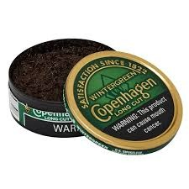
TOBACCO USE
Using tobacco products (to include cigarettes, cigars, cigarillos, smokeless tobacco and/or electronic cigarettes, inhaled tobacco, and all other tobacco products designed for human consumption) is prohibited in all DA-occupied workplaces except for designated smoking areas, as authorized by DODI 1010.15, Smoke-Free DOD Facilities.

Slide 28
URINALYSIS PROGRAM
Random officer selection- US Army
Sister services run their own program
Notification is by phone call, text & email through the ALERT! System
  Registration for ALERT at Fort Leavenworth is required
  Unblock the ALERT phone number
Report IN DUTY UNIFORM at designated time/place
Notify your Chain of Command if you will not be on time (SGA, TL or USSD)
Observers are tasked from sections by USSD to support

Slide 29
BACK PACKS/LOCKERS
No bags can be left unattended anywhere in the building.
DO NOT bring bags into auditoriums.
Use your classroom/lockers for storage
During warfighting application, especially classified blocks use the "puka's" outside door for your electronics and take your bags inside classrooms.

Slide 30
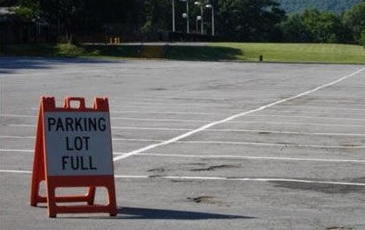
PARKING

Slide 31
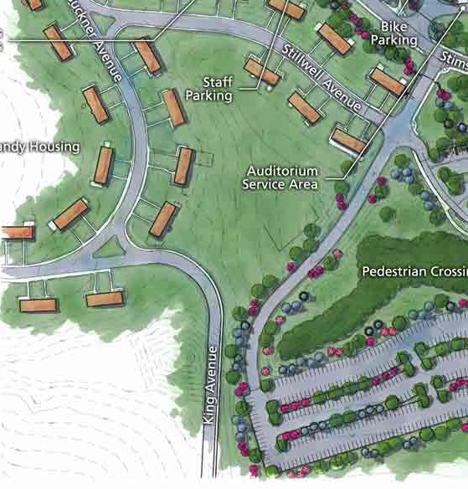
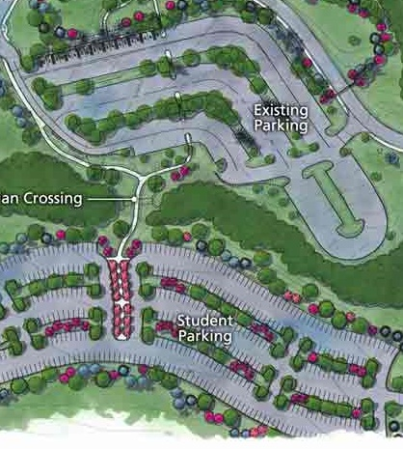
STUDENT PARKING
Do not park at the Golf Course or areas in red!
F - LOT #1
F - LOT #2

Slide 32
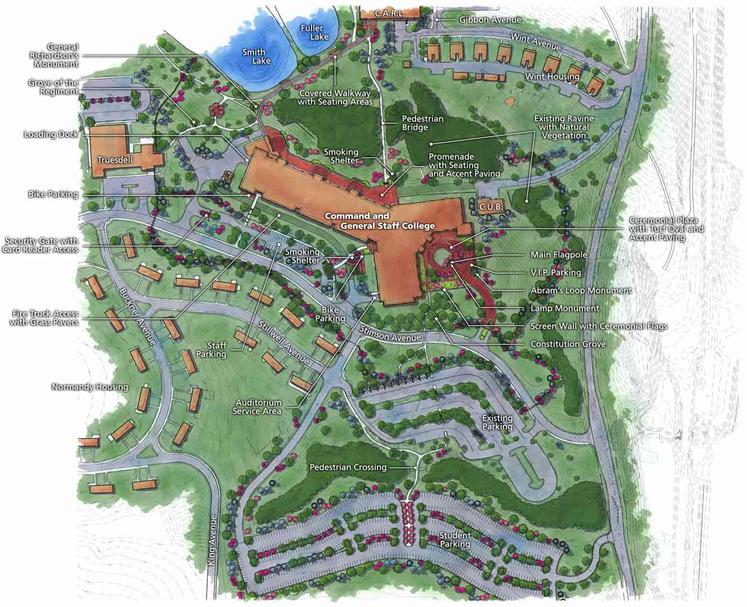
STUDENT PARKING
48 slots
Theater Parking
73 slots
Behind Gruber
462 slots
Old Bell Hall
87 slots
SHERMAN AVENUE
127 slots
Harney Gym
Handicap
BUS STOP
F LOT
#1
F LOT #2
OPEN
PARKING
OPEN
PARKING
260 slots
Behind F-Lot
1057 total slots
available for students
Notes:
F LOT 2 is both north and south sides curb to curb.

Slide 33
STUDENT PARKING
Lewis & Clark lot entry sign examples
F-HANG TAG PARKING ONLY
RESERVED
RED F TAG
PARKING ONLY
STUDENT
PARKING
Motorcycle
Parking
Only
MOTORCYCLE
PARKING
ONLY
NO PARKING ANY
TIME

Slide 34
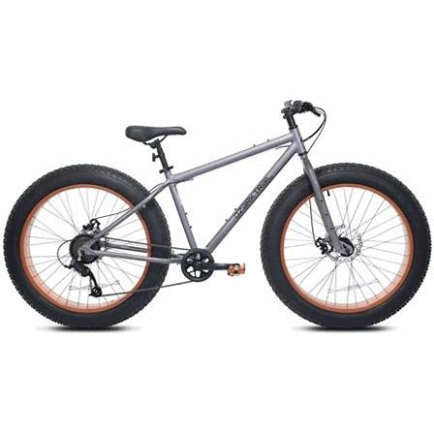
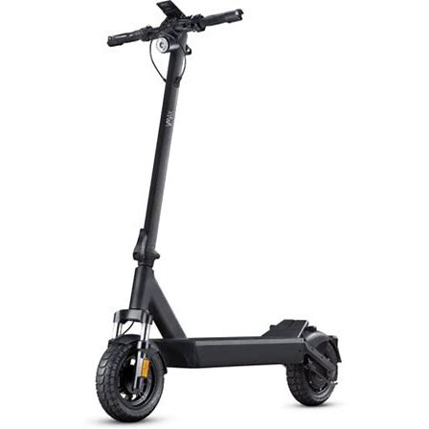
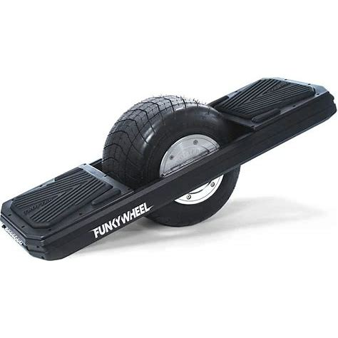
BICYCLES/ELECTRIC TRANSPORATION
Bicycles and all electric transportation must be walked across Grant and all cross walks.
Helmets are REQUIRED
All bicycles and electric transportation cannot be brought into the building and/or left in stairwells.
Please use the bikes racks around the building to store your alternative transportation
Know and follow bike rules on the installation!

Slide 35
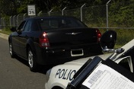
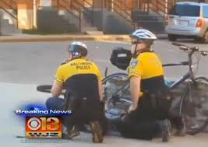
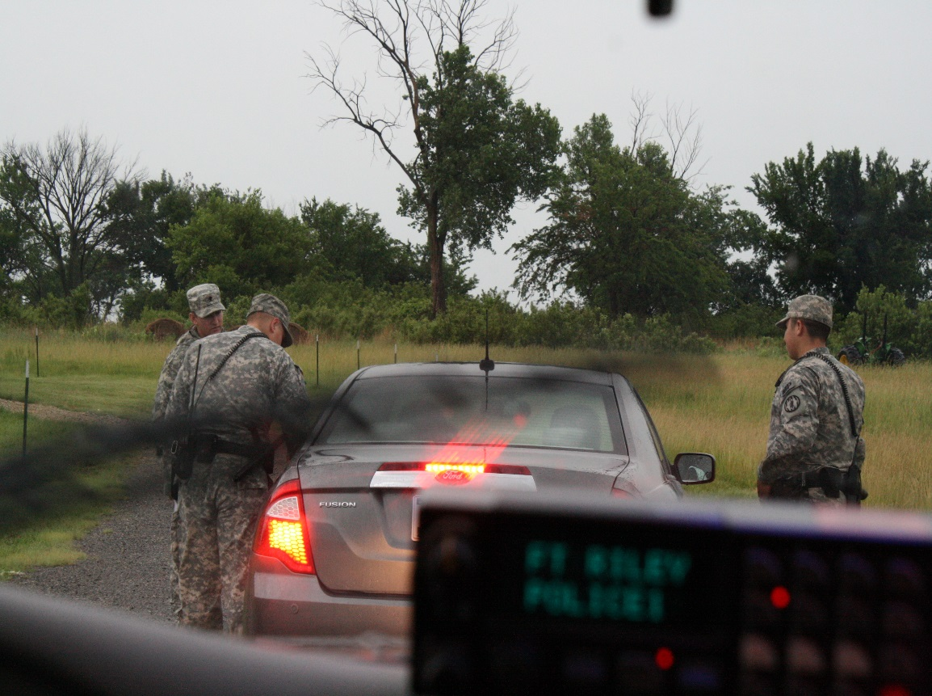
STUDENT DRIVING
Watch your speed!!!
Accumulating 12 points in a rolling year—including dependent violations– will result in suspension of post driving privileges.
Not only on post but in the surrounding areas.

Slide 36
SURGEON CELL
Sick Call Hours: Mon / Wed / Fri 0700-0800
SFC Buckner, CGSC Surgeon Cell NCOIC
  Lewis and Clark, RM 4551
  Email: sylvester.b.buckner.mil@army.mil
SSG Myers, CGSC BHO
  Lewis and Clark, RM 4542
  Email: joseph.c.myers34.mil@army.mil

Slide 37
DENTAL INFORMATION
Smith Dental Clinic near Munson Health Center
Dental Sick call hours are 0730-0900, this is for emergencies. Cracked tooth, missing filling, etc.
Routine appointments can be made at (913) 684-5516

Slide 38
FAMILY CARE PLAN
Once you have all your paperwork together with all the signatures, then contact the Commander to get your paperwork signed.
*Required within 30 days of care at CDC
Dual Military
Single Parents
Geo Bachelor with kids

Slide 39
CONTACT INFO
LTC Amanda Goldman
  Phone:
    Work: 684-7316
    Teams: 520-669-3979
    Office: Room 3522, L&C
Mr. Ty Bruner
  Phone:
    Work: 684-7321
    Teams: 520-669-3594
  Office: Room 3523, L&C
Notes:
Do not text…you will forget to identify yourself and you message cannot be actioned!

Slide 40
CCIR / SIR
CCIR report criteria in 7Ws format:
  Any serious illness, injury, or death of a CGSC student or immediate family member (spouse/child)
  Any violation (or suspected violation) of CGSC academic standards including integrity issues and failures
  Any violation (or suspected violation) of the UCMJ
  General Officer visitors to classrooms
  Changes in the status of students attending CGSC – overall concerns about a student’s fit-for-duty status
  Change in personal status in a student's family, to include his extended family. Changes defined as birth or death, to include a death in a student's extended family
SIR criteria:
  Loss of life/limb/eyesight incident
  DUI, SHARP, EO
  Any event that might bring discredit upon the service / command
If you think it’s something that might be a problem; it is. Call us!

Slide 41
STRESS
If you are having trouble, PLEASE ask for help.
If you think your buddy is struggling don’t ignore the problem; offer help.
Numerous on-off post agencies are available to assist with this challenge:
  Student Detachment Commander/ Deputy
  Behavioral Health NCO on 4th floor room 4542
  Special Troops Battalion Commander (Bldg. 89 by AG)
  Behavioral Health (Gentry Clinic behind Munson)
  Chaplain (4th floor)
  Any other medical professional (Munson, local hospitals)
The CGSC world class faculty are also world class humans! They care about you and truly are always available to assist you!
Notes:
We are here to assist you!

Slide 42
WHEN TO CALL US
When you have an emergency
When you need help
When you need to depart on emergency leave
When your spouse or child is admitted to the hospital
Before it becomes a crisis - bad news does not get better with time

Slide 43
CGSC NEW STUDENT RECEPTION
DATES ACTIVITY
19 AUG Sections 1, 2, 3, 4
20 AUG Sections 5, 6, 7, 8, 17
25 AUG Sections 9, 11, 12, 18
27 AUG Sections 13, 14, 15,19
1745-1800 Assemble (Upper Atrium)
1800-1805 Introduction
1805-1830 Commandant’s Remarks
1830-2100 Socialize
Uniform
Trousers/Khakis, open collar shirt, no tie
Simple skirt or dress, slacks with jacket, pantsuit., Low or flat shoes acceptable
NO Jeans
Notes:
Commandant Reception Sequence of Events

Slide 44
THOUGHTS
Enjoy yourself & keep everything in perspective.
Schedule recurring appointments outside class time if possible.
Account for yourselves!
Do your own work!
Do not mistake this for a typical college environment; remain stewards of your military profession
BE PROFESSIONAL!! Know the standard and be the standard!

Slide 45
DESIGNATED POSITIONS
CGSC CLASS 2027

Slide 46
STUDENT LEADERSHIP
CLASS PRESIDENT
LTC Boone Supinger
CLASS VICE PRESIDENT
MAJ Noah Currie

Slide 47
CLASS POSITIONS
Class Adjutant | CPT (P) Chelsea Donovan
Class Auditor | CPT (P) Kevin Antonich
Class Legal Advisor | CPT (P) Raman Botta
Class IMO | CPT (P) Christopher Counihan
Class H2F | CPT (P) Russell Davis
Class Gift Chairman | MAJ Marlon Whitaker
Class Gift Chairman Assistant | MAJ Vincent Wilmore
Class Gift Finance Manager | MAJ Jianming Wang
Class Gift Marketing Manager | MAJ Melisa Ventre
Class Yearbook Editor in Chief | MAJ Amber Adams
Class Yearbook Managing Editor | CPT (P) Benjamin Peterson
Class Yearbook Business/Finance Manager | CPT (P) Conor Quigley
Class Yearbook Photography Editor | MAJ Roed Mejia
Class Yearbook Section Photo Editor | CPT (P) Ariel McGuirk
Class Triathlon/Iron Major Director | MAJ Deni Adams
Class Triathlon/Iron Major Support Director | CPT (P) Allen Copas

Slide 48
CLASS SECTION LEADERS
SECTION | SG | Name
1 | A | LLANIO, JAMES KERRY
2 | A | DENNISON, DENZIL
3 | A | KALINKA, JOSEPH
4 | A | JONES, MARGARET JOANNE
5 | A | MCCLELLAN, EDWARD RUSSELL
6 | A | ARGUELLO, SHANE ALEXANDER
7 | A | BETHEA, KAYLA LEIGH
8 | A | RIGDON, JEFFREY ALLEN
9 | A | FLORES, SHELLEY ANN
11 | A | DEFABIO, ANDREW NOLEN
12 | A | THORSEN, ERIC
13 | A | PRICE, MONDAY ARIANNE
14 | A | HAMEL, MICHAEL CHRISTOPHER
15 | A | KEGG, DAVID MICHAEL
17 | A | SHOBE, MANDY L
18 | A | KISH, ETHAN
19 | A | LIN, CHARLES K

Slide 49
CLASS 2027 ADJUTANTS
CPT (P) Donovan, Chelsea | 1A
CPT (P) Silao, Frankie | 2A
MAJ Balzer, Brooke | 3A
MAJ Lin, Nerissa | 4A
CPT (P) Peric, Crystal | 5B
CPT (P) Stitt, Erica | 6A
MAJ Oelschlaeger, Ashley | 7A
MAJ Book, Gabriel | 8A
CPT (P) Schoorl, Kyle | 9A
CPT (P) Samuel, Craig | 11A
MAJ Miller, Jasmine | 12B
MAJ Wagner, Joseph | 13A
CPT (P) Spicer, Kristopher | 14B
CPT (P) Dagny, Hillary | 15B
CPT (P) Herron, Christopher | 17A
MAJ Bonfe, Tyler | 18B
MAJ Riehle, Nicholas | 19A

Slide 50
0800, 14 August
Student Leadership (Class, Section) and Class Officers
Marshal Auditorium
CLASS 2027 STUDENT LDRSHIP

Slide 51
0800, 14 August
Class and Section Adjutants
Arnold Conf Room (3rd Floor)
CLASS 2027

Slide 52
QUESTIONS?

Slide 53
CGSC IMPORTANT DATES
Medical in-processing
  21 JUL (0745-1600) Classrooms 4307-4310/4316-4319
  23 JUL (0745-1600) Classrooms 4307-4310/4316-4319
  28 JUL (0745-1600) Classrooms 4307-4310/4316-4319
Branch Prep Courses
  22-24 JUL (0830-1600) Various Classrooms
CGSS School Program Briefs
  29 JUL (0830-1720) L&CC Eisenhower Auditorium
Branch Day
  30 JUL (0830-0930) L&CC Eisenhower Auditorium
USSD in Brief
  31 JUL (0830-1520) L&CC Eisenhower Auditorium

Slide 54
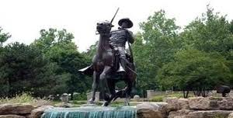
Welcome
Congratulations on your selection!
Class 2027

